Slide 1
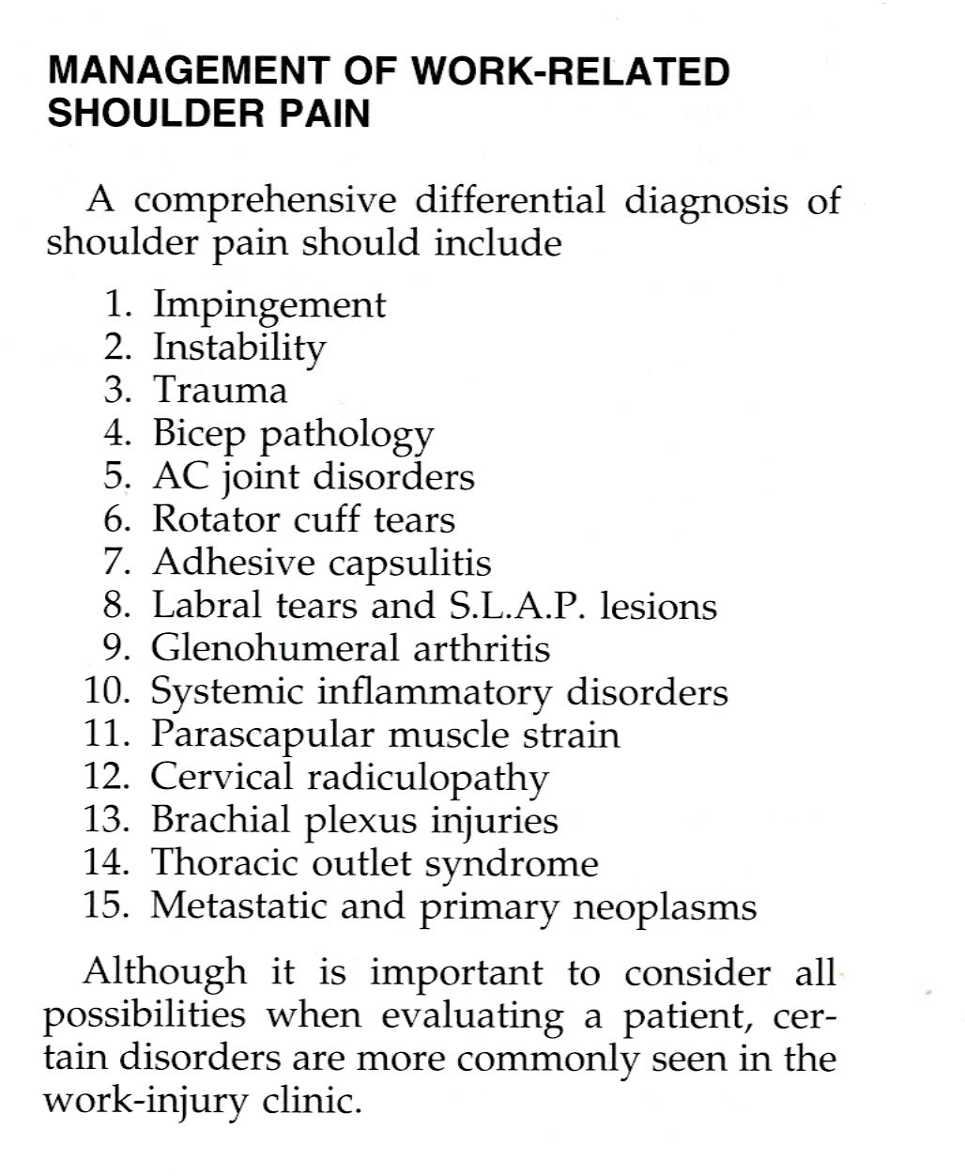

Slide 2
Shoulder pain
Impingement (strike, to encroach; Κορακα)
Stage I Reversible oedema - 25 yrs
Stage II Irreversible fibrotic changes 25 – 40 yrs
Stage III Bone spurs on the acromion and rot. Cuff tears
Stage I and early II - treatment – Conservative, nonsurgical
Stage II late and III - treatment - Surgical : acromioplasty +/- Rotator cuff
Repair

Slide 3
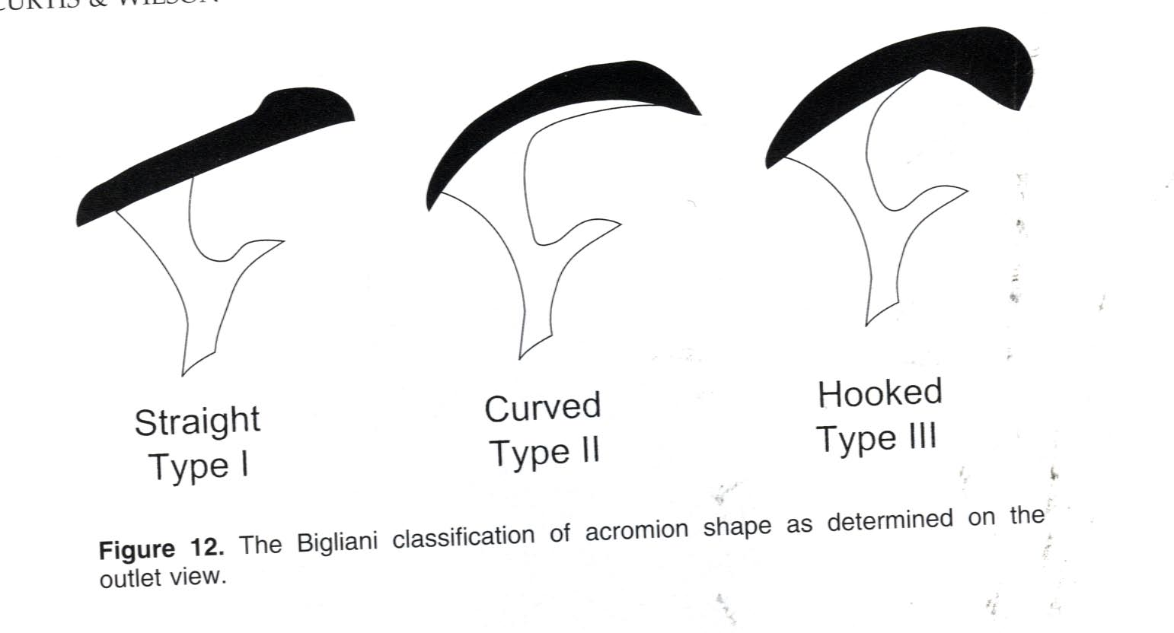
Shoulder Impingement

Slide 4
REHABILITATION OF THE SHOULDER
Phase 1: Protection and Resolution of symptoms.
Phase 2: Restoration of Motion.
Phase 3: Restoration of strength and dynamic stability.
Phase 4: Return to work.

Slide 5
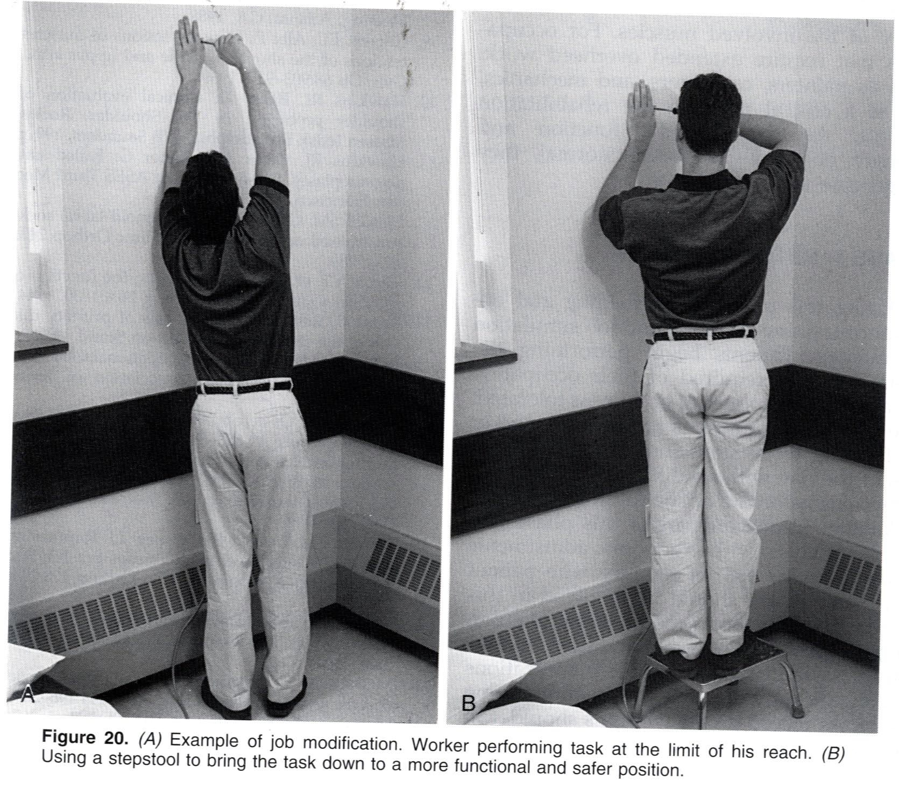
Shoulder

