Slide 1
THE PREVALENCE OF OSTEOPOROSIS IN PRIMARY OSTEOARTHRITIS.
PRACTICAL AND THEORETICAL SIGNIFICANCE
Dr Hadjichristofis Stelios FCS(SA)Orth. / MMed(WITS)Orth.
South Africa . University of Witwatersrand
Master Degree Thesis

Slide 2
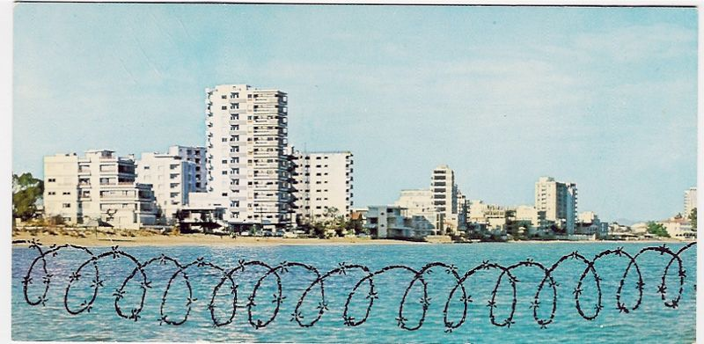
1974
FAMAGUSTA
2011
FAMAGUSTA
THE GHOST TOWN

Slide 3
THE PREVALENCE OF OSTEOPOROSIS IN PRIMARY OSTEOARTHRITIS. PRACTICAL AND THEORETICAL SIGNIFICANCE
To establish the prevalence of osteoporosis in patients undergoing Total Hip Replacement for Osteoarthritis:
66 patients (53 females and 13 males)
mean age of 68,7 years(range 50 to 80 years)
were investigated for osteoporosis.

Slide 4
THE PREVALENCE OF OSTEOPOROSIS IN PRIMARY OSTEOARTHRITIS. PRACTICAL AND THEORETICAL SIGNIFICANCE
The diagnosis of osteoporosis was established:
by the presence of vertebral fractures,
by measurement of bone mineral density (BMD) of the Lumbar spine by Dual energy
x-ray absorptiometry (DEXA) and
combined cortical thickness (CCT) of the second metacarpal mid-shaft.

Slide 5
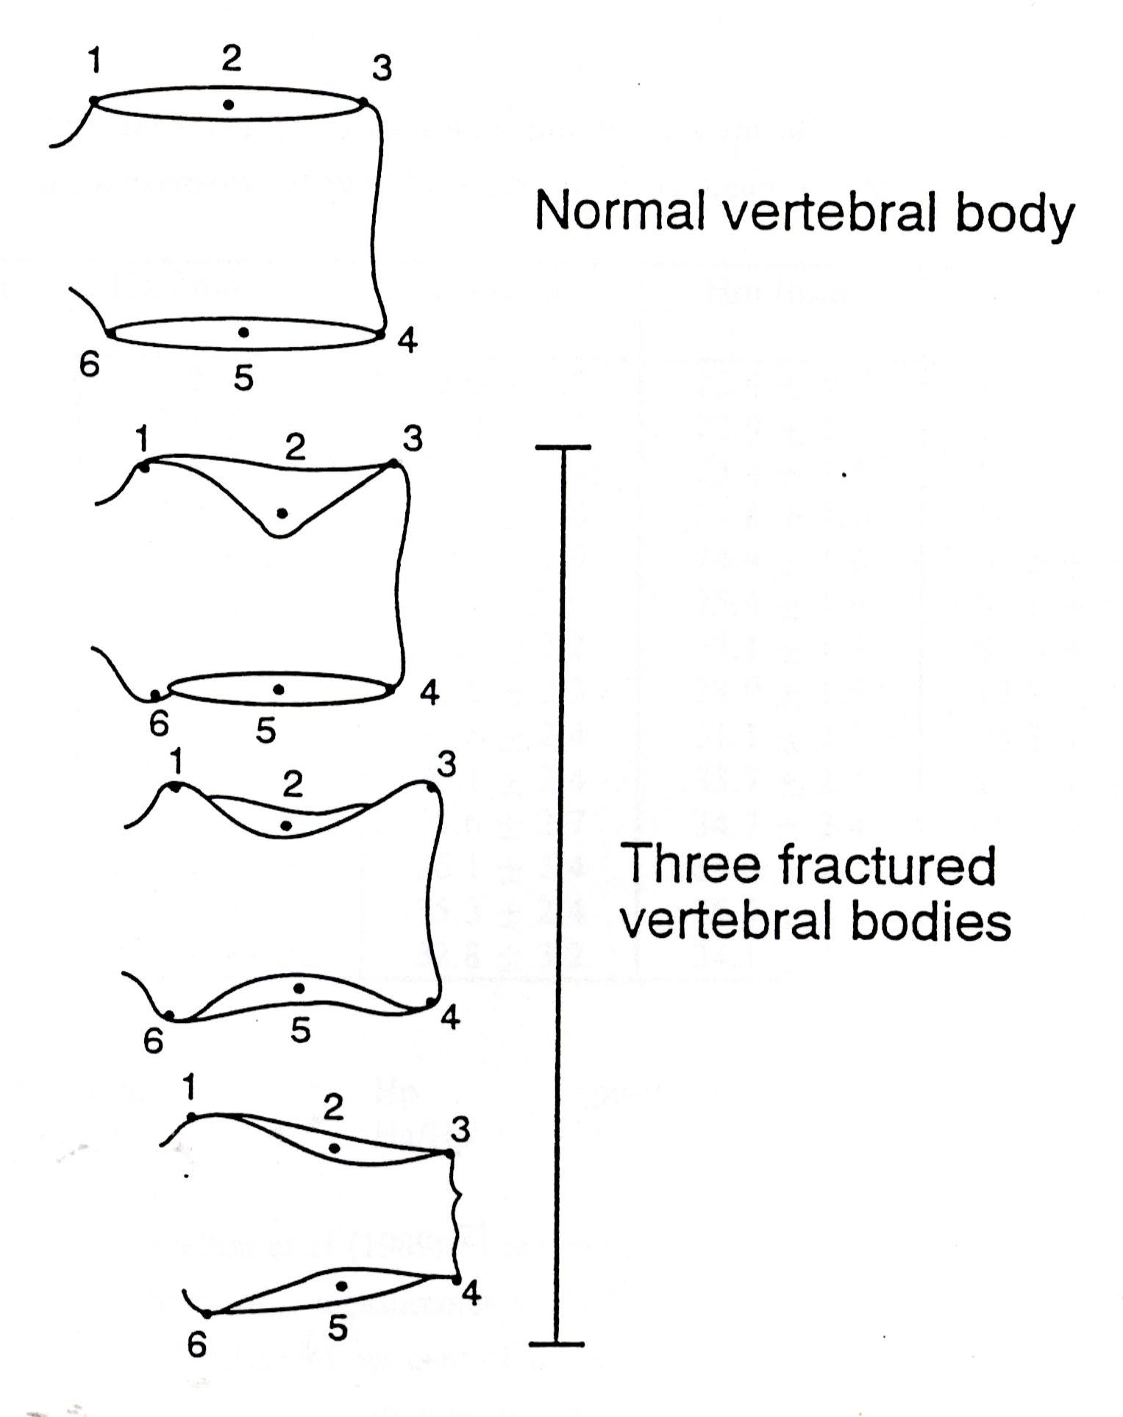
Placement of points for measurements
Anterior height (Ha) 3 to 4
Mid Height (Hm) 2 to 5
Posterior Height (Hp) 1 to 6
Vertebral fractures were defined on lateral
radiographs of the thoracic and lumbar spine
by measuring the anterior, posterior and
middle height of each vertebra.

Slide 6
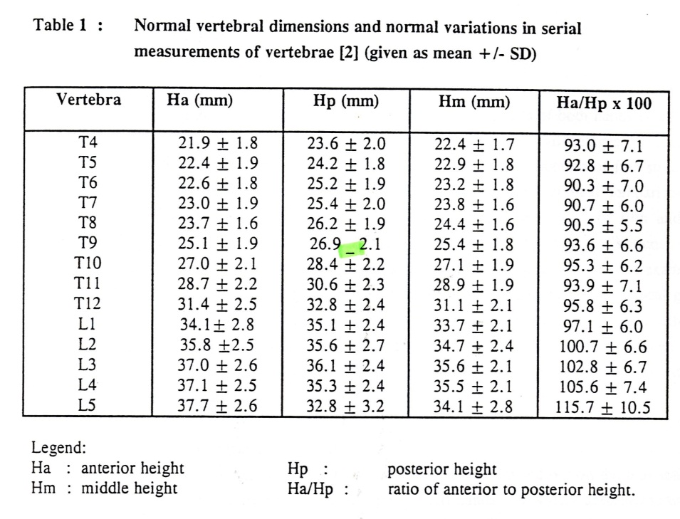

Slide 7
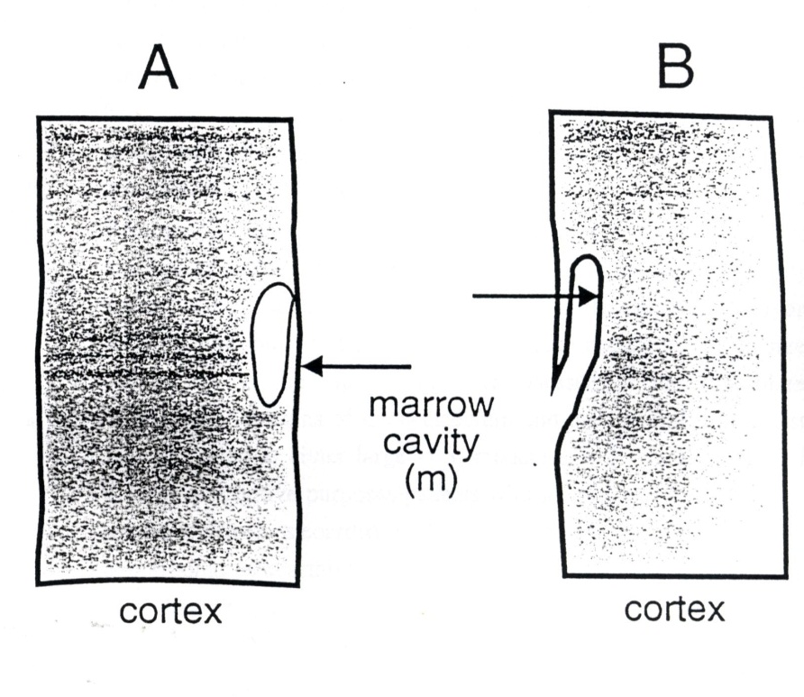
combined cortical thickness (CCT) of the second metacarpal mid-shaft.
Combined cortical thickness of the second metacarpal
mid-shaft was measured on postero-anterior radiographs
of both hands using industrial fine grained single
emulsion film for fine detail.
Measurement of Cortical
thickness in the presence of
Juxtaendosteal resorption

Slide 8
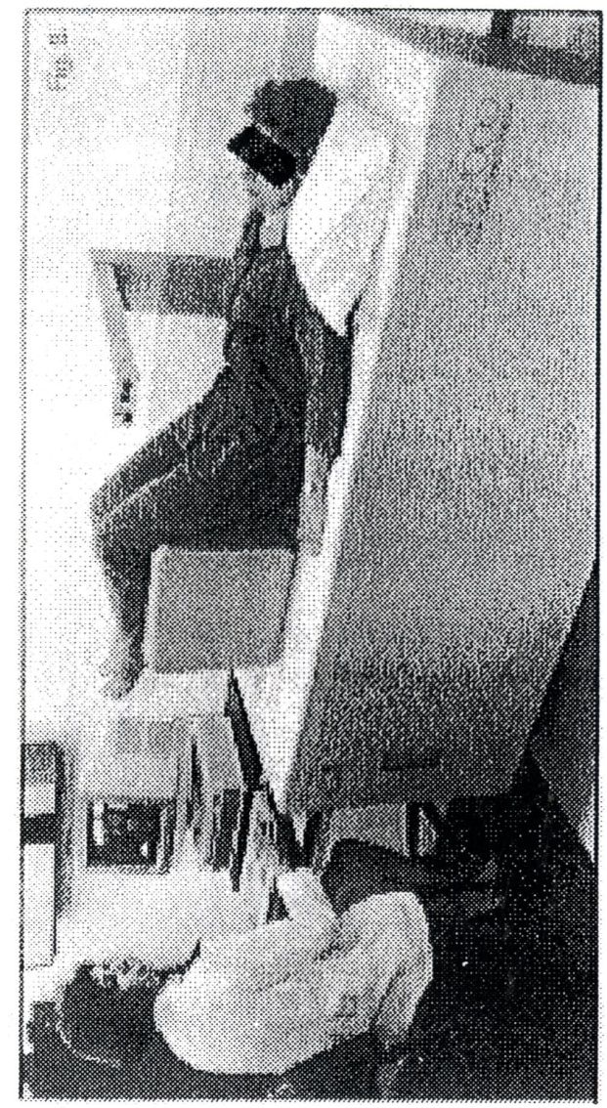
Bone densitometry was performed by DEXA on the Lumbar spine
from L1 to L4. The World Health Organization (WHO) classification
was used to classify the severity of bone loss according to the
T-score findings.
WHO Classification
Normal = 0 to -1SD from the young adult mean;
Osteopenia (low bone mass = -1 to -2.5 SD below the young normal adult mean;
Osteoporosis = more than -2.5 SD below the young normal mean without
radiological evidence of fragility of fractures;
iv) Severe osteoporosis = same as (iii) but with fragility fractures present
Spinal densitometer in Operation

Slide 9
For purposes of Analysis patients were subdivided into four groups according to the following criteria
▶ Group 1 : Patients with normal bone.
▶ Group 2 : Osteoporotic patients. The diagnosis of osteoporosis
was based on the densitometry findings (WHO criteria)
and on the presence of vertebral fractures in the
Thoracic and/or lumbar spine as described in chapter II.
▶ Group 3 : Osteopenic patients. The diagnosis was basedon the
WHO definition (BMD between -1 and -2.5 SD below the
young normal mean).
▶ Group 4 : All patients with abnormal bone which is group 2
(osteopenia) and group 3 (osteoporosis) taken together.

Slide 10
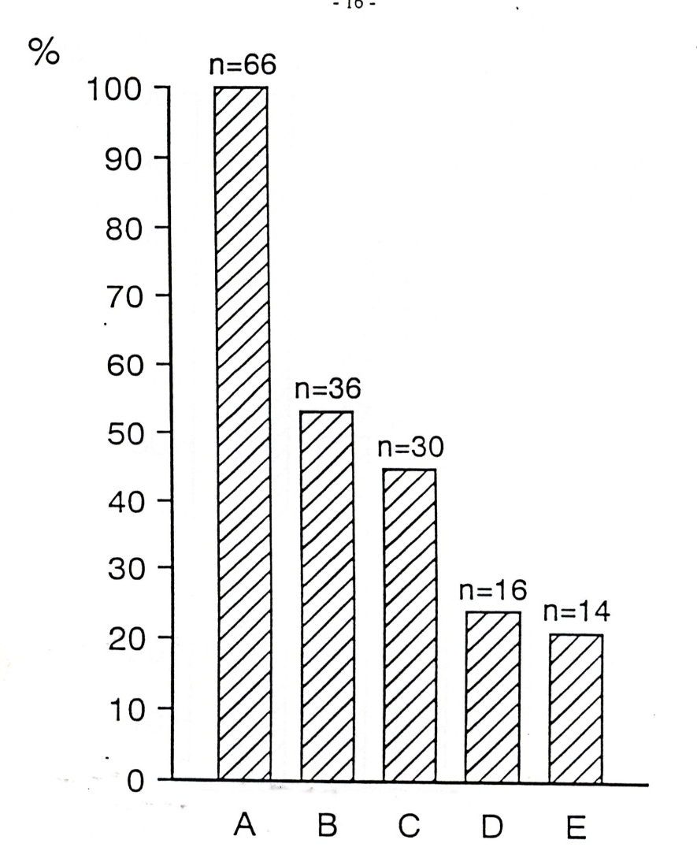
Block diagram of the 66 patients 53 females
and 13 males with primary osteoarthritis
undergoing Total Hip Replacement.
--------------
A : Total number of patients = 66 (100%)
B : Patients with Normal bone = 36 (54.5%)
C : Patients with Abnormal bone.
Osteopenic and osteoporotic patients =
30 (45.5%).
D : Osteoporotic patients =16 (24.2%)
E : Osteopenic patients = 14 (21.2%)

Slide 11
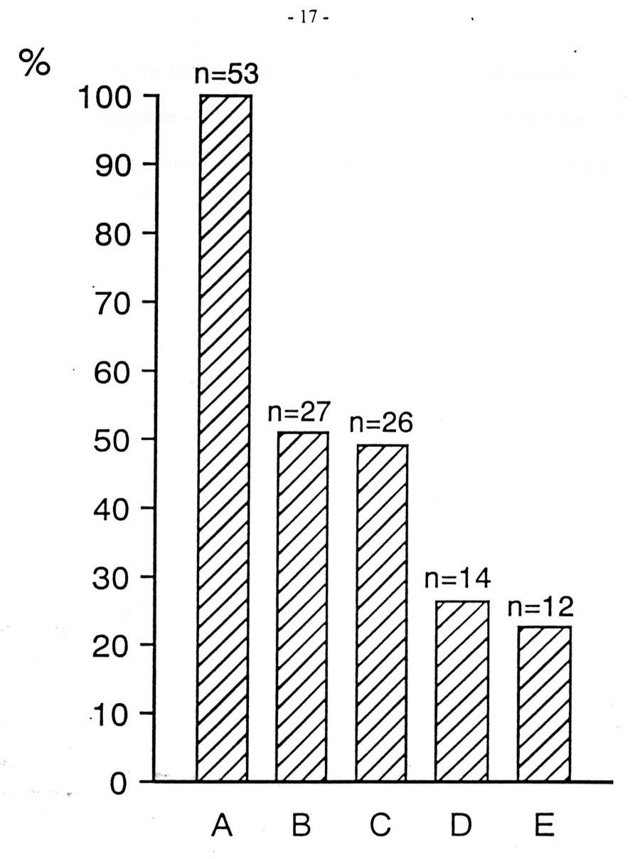
Block diagram grouping 53 postmenopausal
Women with primary osteoarthritis
undergoing Total Hip Replacement by
severity of bone disease. Male patients
not included in this diagram in order to
more accurately reflect the findings in the
female group.
-------------------------
A : Total number of patients = 53
B : Number of patients with normal
bone = 27 (51%)
C : Patients with abnormal bone.
Osteopenic plus osteoporotic
patients = 26 (49.1 %)
D : Osteoporotic poatients = 14
(26.4 %)
E : Olsteopenic patients =12
(22.6 %)

Slide 12
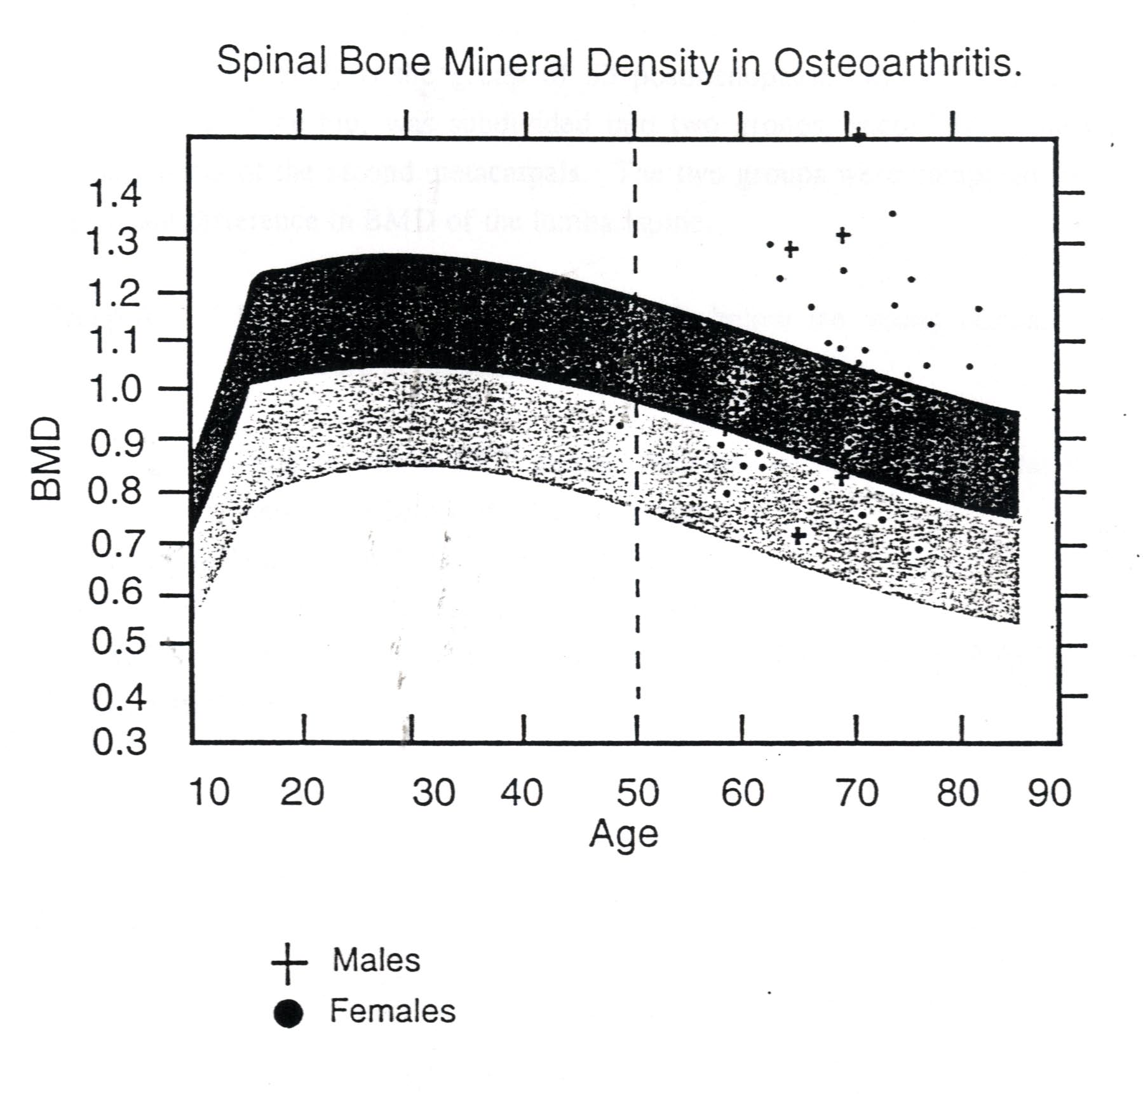
Bone Mineral Density (BMD)of the Lumbar spine of the 66 patients
(present series) above the age of 50 years with primary osteoarthritis (53
Females and 13 males) compared to Reference database.
Shaded Areas:
Dark represents +2SD above mean
Light represents – 2SD below mean

Slide 13
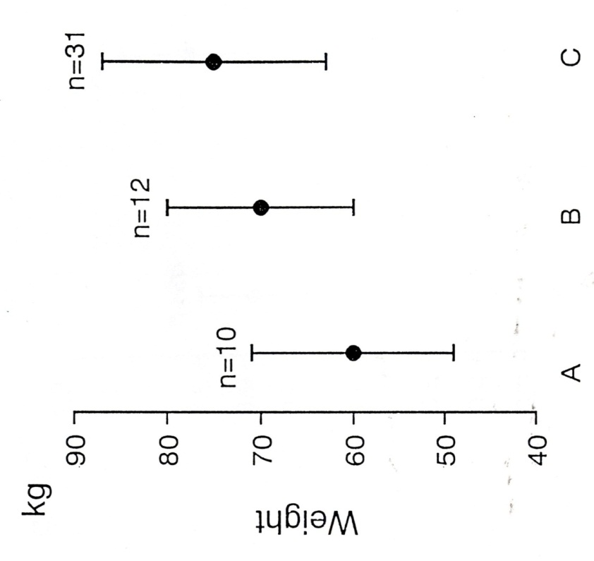
Comparison of body weight in osteoarthritic patients
With different T-scores on DEXA measurements
Group A:10 patients T-score < 2SD
MBW = 60+/-11,5kg
Group B:12 patients T-score -1SD to -2SD
MWB = 70+/- 10 kg
Group C:31 patients T-score > -1SD (normal bone)
MWB = 75 +/- 12 kg
The mean body weight in group A was significantly lower than in Group C
(p-value = 0.0007; z-test)
The mean body weight of the patients in Group B tended to be higher
That in Group A and lower than that in Group C.

Slide 14
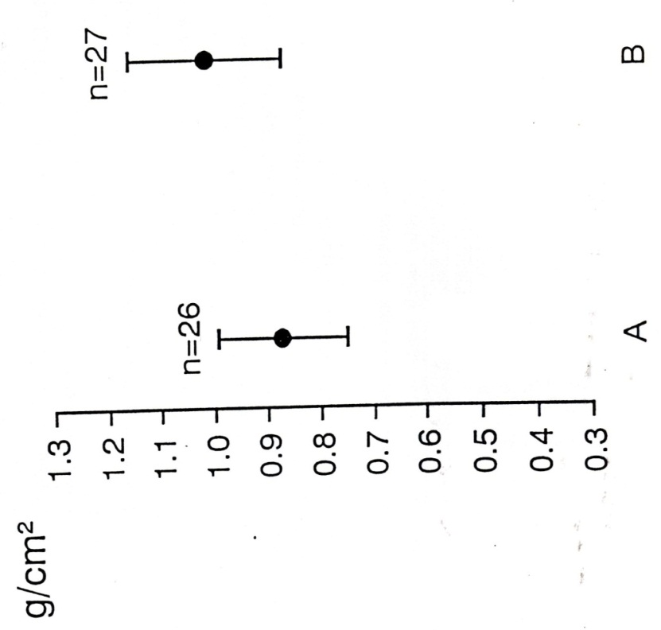
Spinal bone mineral density in patients with low & high CCT
The group of fifty-three postmenopausal women
With primary osteoarthritis of the hip was
Subdivided into two groups according to CCT
measurements of the second metacarpals. The
two groups were compared for any significant
Difference in BMD in the Lumbar spine.
Group A: 26 patients with a CCT below -2SD of
young normal mean. The normal mean BMD of
the Lumbar spine in this group was 0.873 +/- 0.121.
Group B: 27 patients with a CCT above -2SD of the
young normal . The mean BMD in group B was
1.014 +/- 0,143.
The BMD in group A was significantly lower than in Group B
(p-value =0.003; z-test)

Slide 15
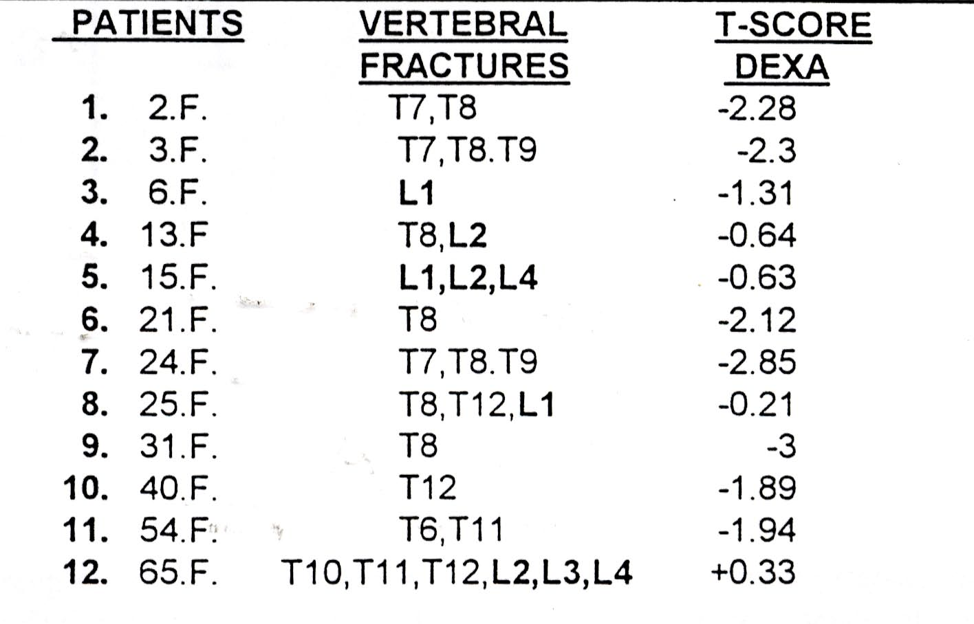
Level of the vertebral fractures and the corresponding DEXA T-score of
The Lumbar spine
Of the 53 postmenopausal women with primary osteoarthritis, 12(22,6) had two or more vertebral fractures.

Slide 16
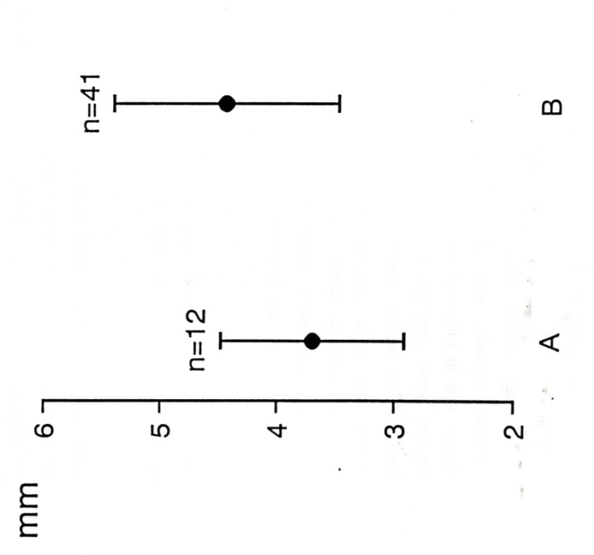
Combined Cortical Thickness CCT
in patients with & without vertebral fractures
Group A : 12 patients with Vertebral fractures
Group B : 41 patients without Vertebral fractures
The mean CCT of the second metacarpal midshaft in group A was
significantly lower than that in group B, (p-value = 0.0085 ; z-teast)

Slide 17
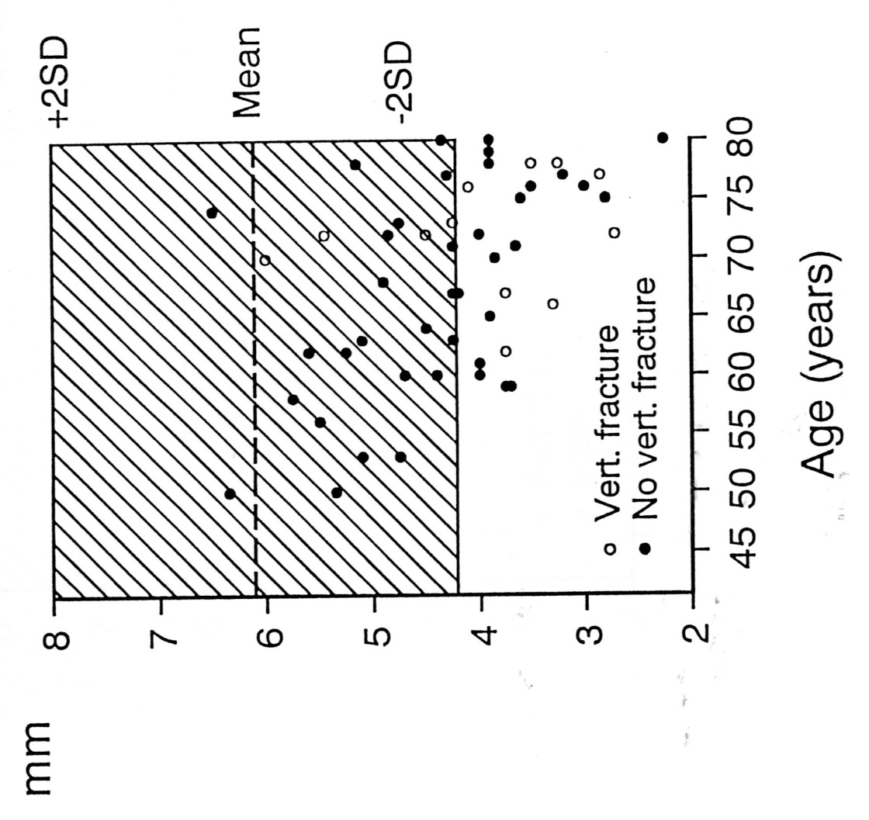
Combined Cortical Thickness (CCT) in postmenopausal women
with and without vertebral fractures
Shaded area : The normal range
In young healthy women aged 21 to 45
Years (Meema 1987)
CCT at the second metacarpal mid-shafts
In 53 postmenopausal women with primary
osteoarthritis

Slide 18
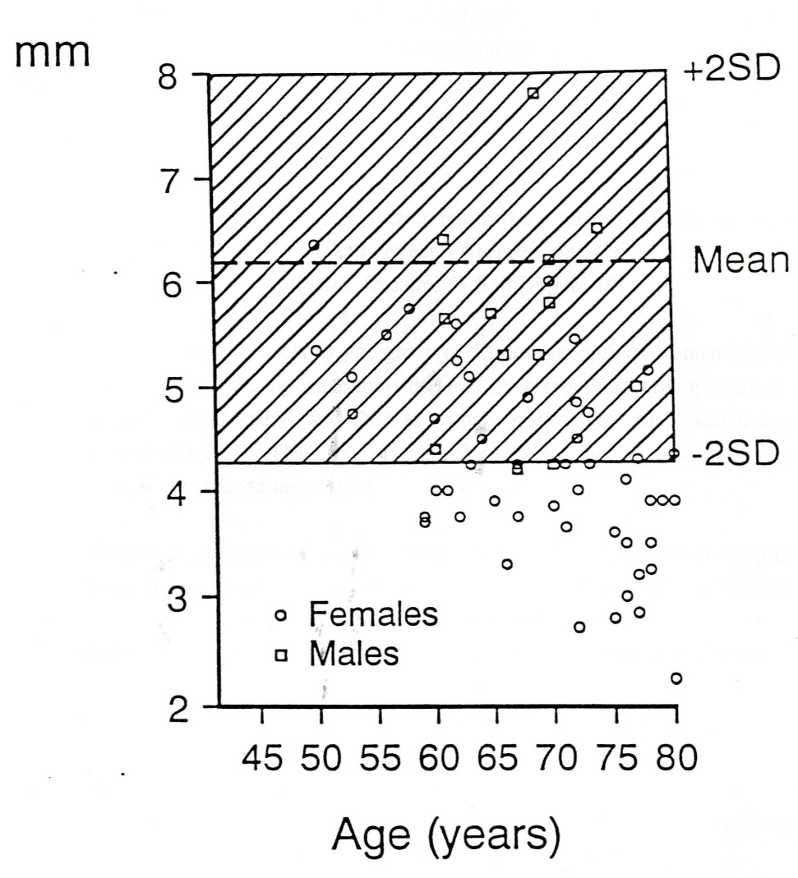
Combined Cortical Thickness (CCT)
Shaded area : The normal range
In young healthy women aged 21 to 45
Years (Meema 1987)
Males can not be compared to these reference data
Because no reference data for males are available.

Slide 19
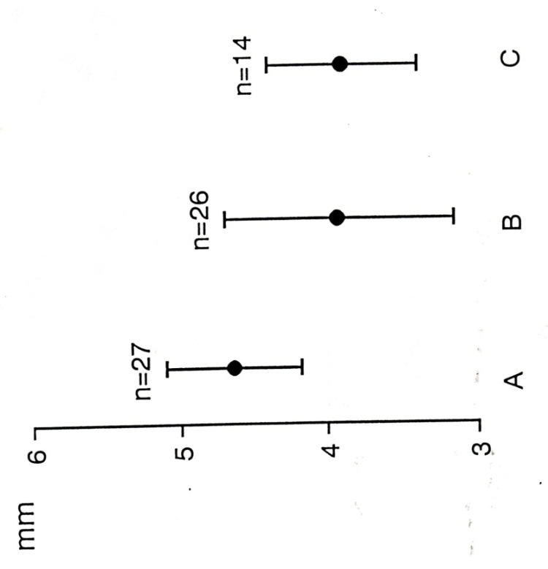
Combined Cortical thickness by severity of bone loss
(diagnosed by DEXA and /or vertebral fractures)
Group A : 27 patients with normal bone. The
mean CCT was 4.64 +/- 1.06
Group B : 26 patients with abnormal bone
(osteopenic and osteoporotic patients).
Mean CCT - 3.93 +/- 0.77
Group C : 14 patients with osteoporotic bone.
Mean CCT 3.73 +/- 0.75
The mean CCT in group C was significantly lower than that in group A
(p-value = 0.0026)

Slide 20
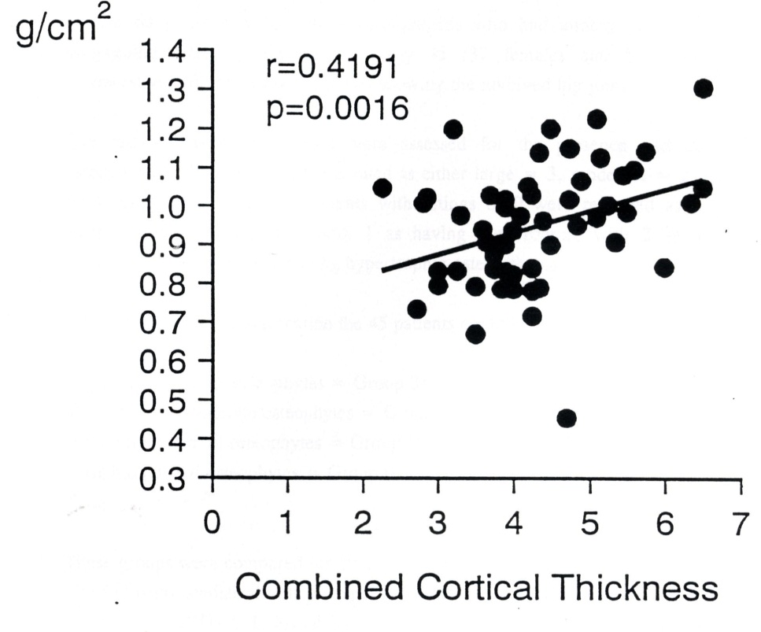
Spinal Bone Mineral Density
Positive correlation between CCT and BMD in 53 postmenopausal women
with primary osteoarthritis of the Hip. Pearson correlation coefficient

Slide 21
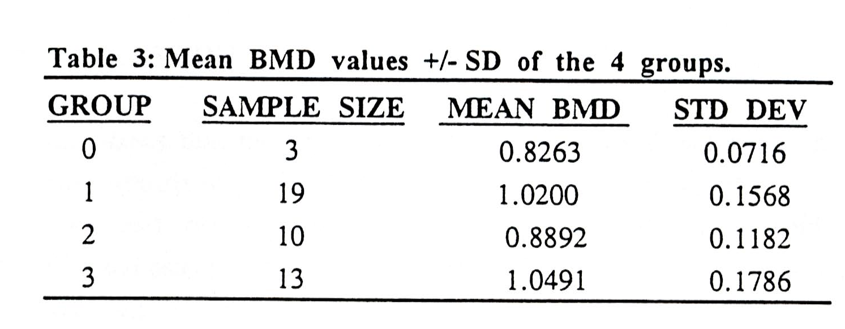
Radiographs of the Pelvis – Assessed for the presence and size of osteophytes
45 patients had previous radiographs.
Osteophytes were rated : Large=0, Moderate=2, small=1, Absent=0
The 45 patients were grouped as follows:
Hypertrophic (large osteophytes) = Group 3 : 13
Supertrophic (moderate osteophytes) = Group 2 :10
Hypotrophic (small osteophytes) = Group 1 :19
Atrophic (absent osteophytes)= Group 0 :3
Group 0 (atrophic osteoarthritis) had a significantly lower mean value of BMD
The results are not reliable because there were only 3 patients in the group.
Statistical analysis of the different groups did not
establish any significant trend

Slide 22
Osteoarthritis and Osteoporosis do coexist and the previously
held notion that Osteoarthritis and osteoporosis are two mutually
exclusive diseases is incorrect
◆ Pogrund et al(1982) examined the prevalence of ostearthritis and
Osteoporosis in a random population sample in Jerusalem, using a
subjective and unsubstantiated radiographic method. The Authors
concluded that OA and OP are two independent unrelated processes.
In the present group the prevalence of osteoporosis was 26,4% which
is significantly higher(p<0.0093; z-test).
◆ In the WHO study on Osteoporosis, the prevalence of osteoarthritis
and osteoporosis in postmenopausal women(in general) above the age
of fifty was 30%.
In the present group of Osteoarthritic patients the prevalence of
osteoporosis was 26.4% which is not significantly lower than the WHO
Figure (p = 0.5687; z-test).

Slide 23
Conclusion
Osteoporosis is as common in patients with osteoarthritis of the hip as it is in the general population.
These patients should be identified before total hip replacement surgery in order to take the necessary precautions that will prevent a compromised postoperative outcome.
Patients at risk for osteoporosis are postmenopausal women with low body weight.
These women should have DEXA examination, and in its absence lateral radiographs of the dorsal and lumbar spine should be assessed for fractures, and the CCT should be measured on a PA radiograph of the hands.

Slide 24
Conclusion – Message for Orthopaedic Surgeons
Patients undergoing total hip replacement for primary osteoarthritis, especially high risk patients (white postmenopausal women with low body weight) , should be investigated for osteoporosis.
The need for such an investigation (DEXA) arises out of the increased risk of complications when the bone is poor, such as fracture of the femur during broaching or perforation of the acetabulum during reaming.
Moreover, even though there is no literature support, many orthopaedic arthroplasty surgeons recommend the patients with bone of poor quality (decreased bone density) should have a cemented total hip replacement.
Finally poor quality bone may influence the outcome of the arthroplasty and it could be an important factor causing early loosening of the implants.

Slide 25
Thank you

