Slide 1

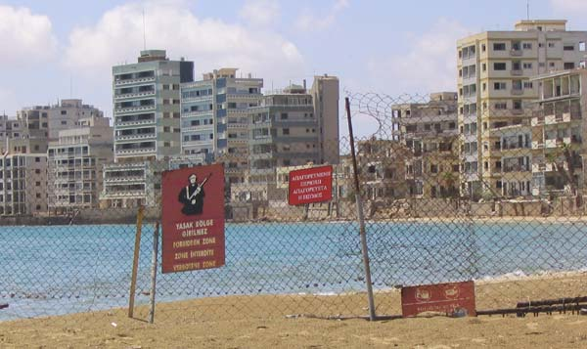
FAMAGUSTA
1974
FAMAGUSTA
A HOSTAGE
TOWN
2008

Slide 2
Treatment of Intertrochanteric and peritrochanteric Fractures
Intramedullary Nail With Integrated
Cephalocervical Screws and Linear Compression
Hadjichristofis Stelios FCS(SA)Orth. / Mmed(WITS)Orth. S.A. WITS
The author did not receive any financial support related to this presentation.

Slide 3
Intertrochanteric and Subtrochanteric Fractures
Personal experience Using INTERTAN -an Intramedullary Reconstruction Nail
☺ December 2007 to December 2010
I have treated 29 patients in my Private practise in
Johannesburg
&
☺March 2011 to July 2016 I have treated 22 patients
in Cyprus
with a new trochanteric antegrade nail (InterTan; Smith–Nephew, Memphis, TN).

Slide 4
Intertrochanteric and Subtrochanteric Fractures
Personal experience Using INTERTAN -an Intramedullary Reconstruction Nail
INTERTAN Intramedullary Reconstruction Nail
This is new device for the treatment of intertrochanteric fractures that uses 2 cephalocervical screws in an integrated mechanism allowing linear intraoperative compression and rotational stability of the head / neck fragment.

Slide 5
Intertrochanteric and Subtrochanteric Fractures
Personal experience Using INTERTAN - an Intramedullary Reconstruction Nail
I have used the devise for
comminuted intertrochanteric fractures,
Unstable subtrochanteric fractures and
combination of peritrochanteric fractures with femoral shaft (segmental).
Osteoporotic fractures
Younger patients after high impact motor vehicle accidents and older patients with osteoporotic bones.
The age ranged between 33 and 91.
I have used long and short nails. For the osteoporotic intertrochanteric fractures I have used short nails. I have followed all these patients in my private practice myself.

Slide 6
Intertrochanteric and Subtrochanteric Fractures
Personal experience Using INTERTAN - an Intramedullary Reconstruction Nail
The surgical time ranged from 50 to 131 minutes.
This rose significantly with the complexity of the fracture. The theatre time was much less using the short nails (50 to 65 minutes)
All fractures healed within 16 weeks (range 10–16 weeks).
Radiologically there was no loss of reduction, no uncontrolled collapse of the neck, no nonunions.
There was only one distal locking screw breakage in patients with segmental Fractures (Femoral shaft) – long nail.

Slide 7
Intertrochanteric and Subtrochanteric Fractures
Personal experience Using INTERTAN - an Intramedullary Reconstruction Nail
The InterTan device appears to be a reliable implant for the treatment of complicated peritrochanteric and segmental femoral fractures.
Its design provides for stability against rotation and minimizes neck malunions (shortening) through linear intraoperative compression of the head/neck segment to the shaft.
I believe this devise is giving an extra dimension in the femoral intramedullary fixation.

Slide 8
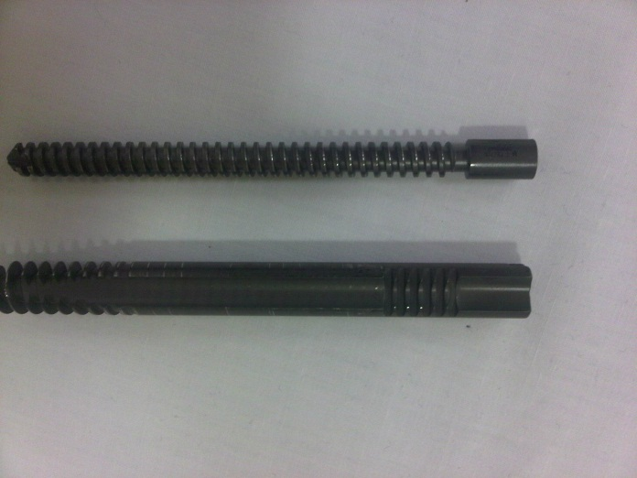
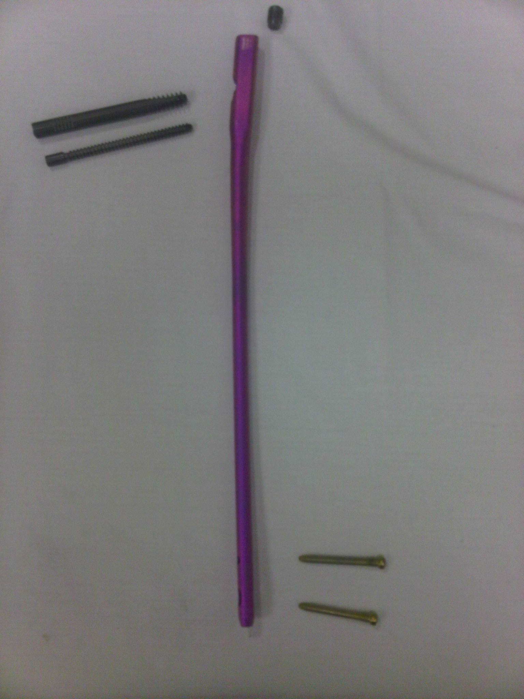
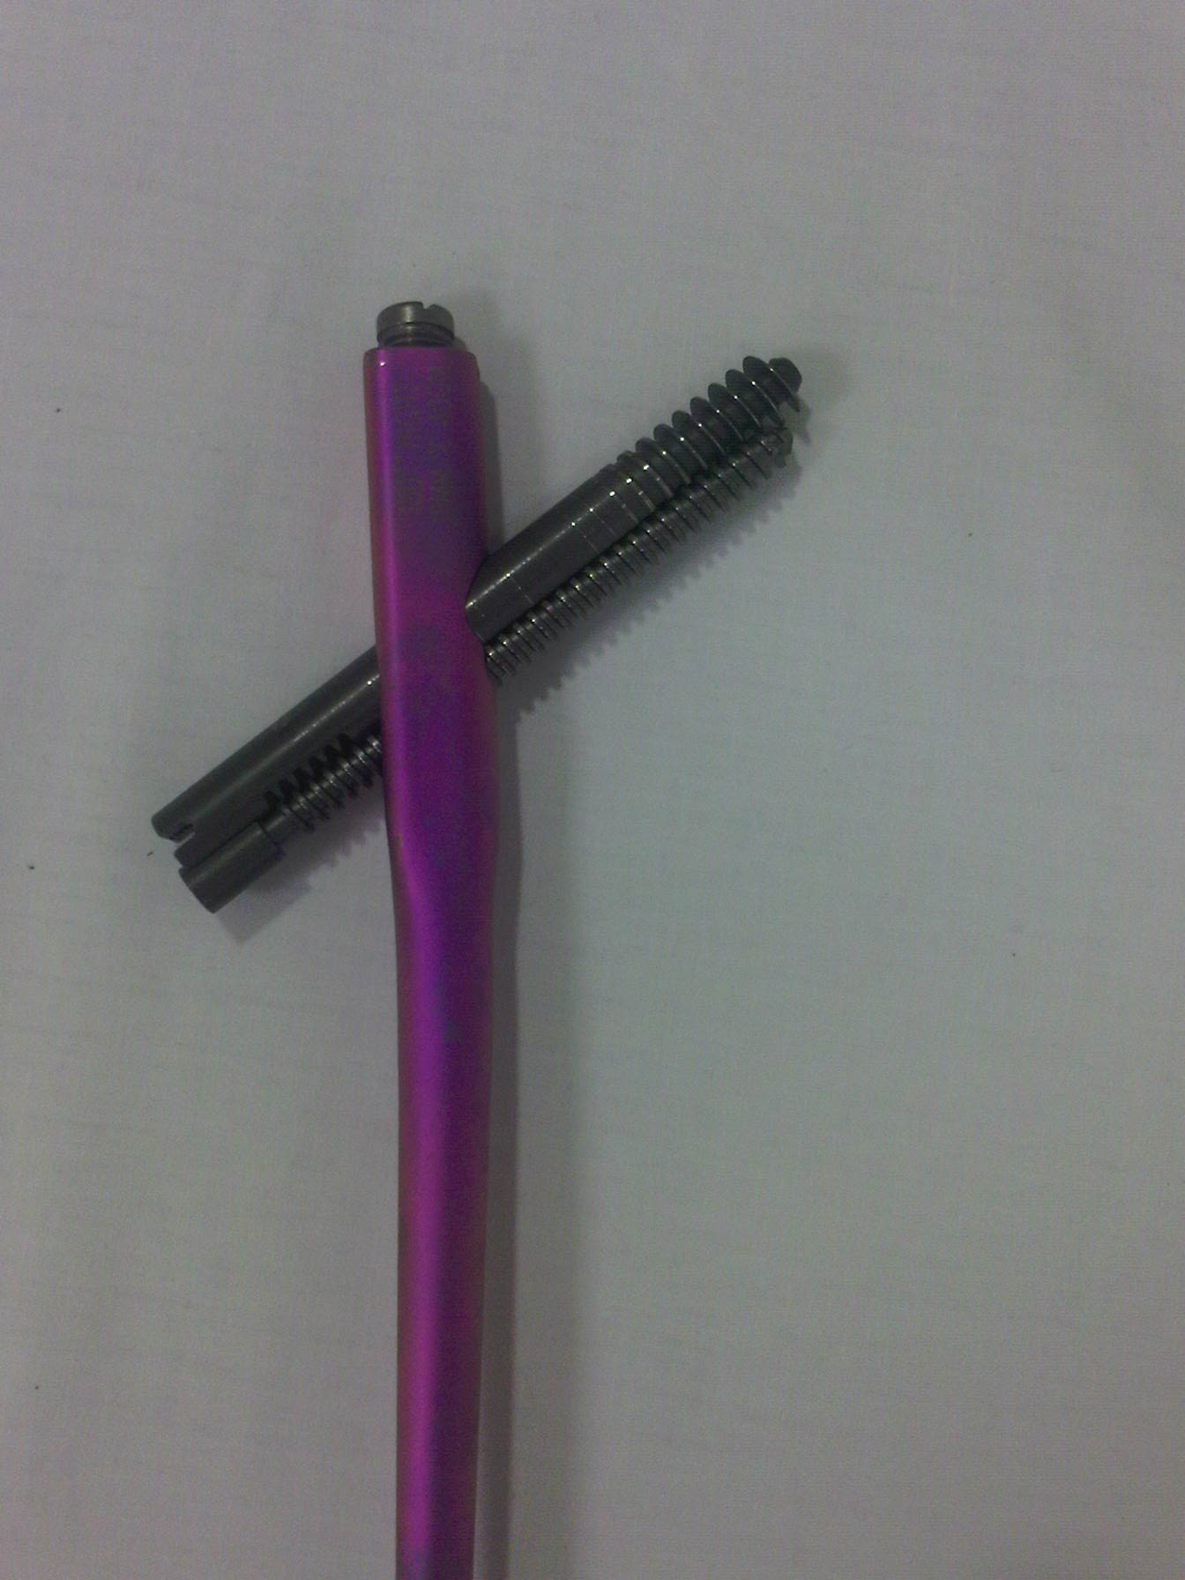

Slide 9
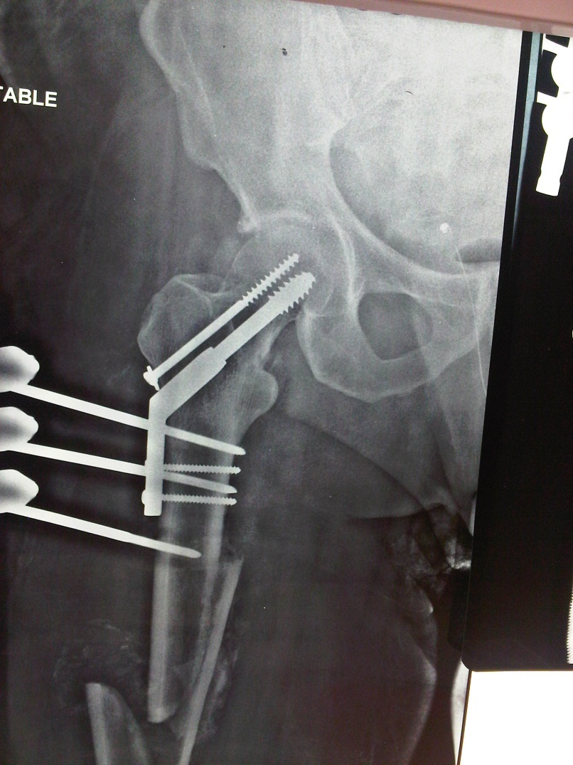
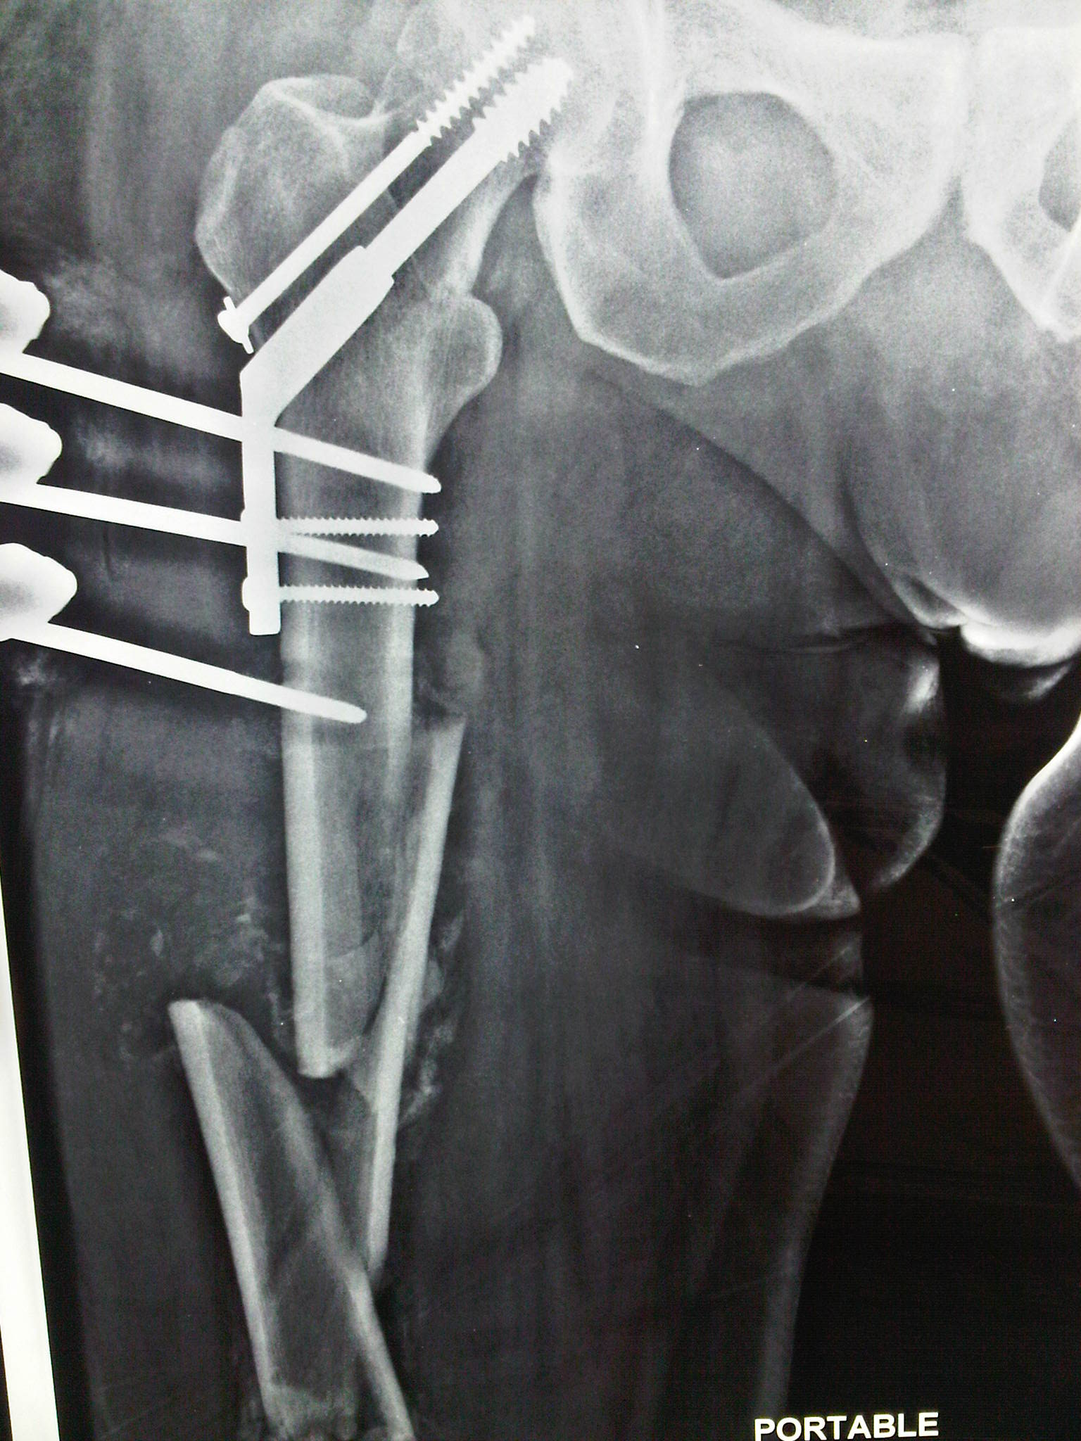
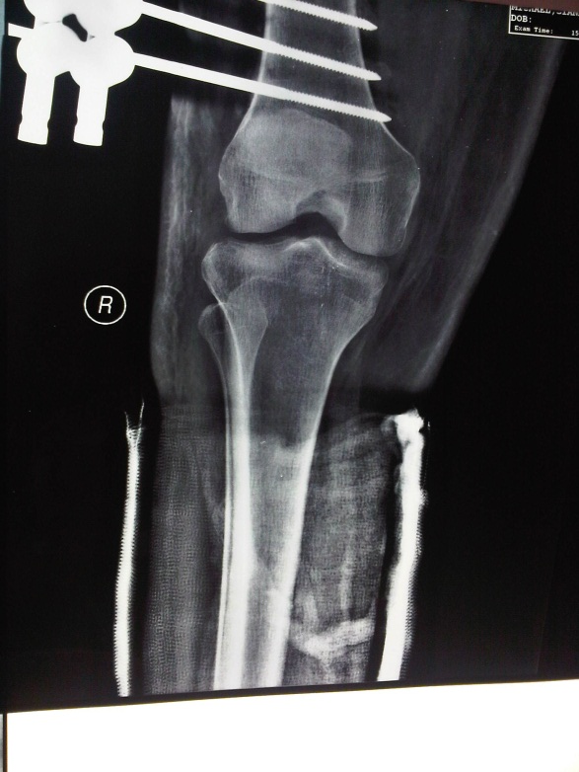

Slide 10
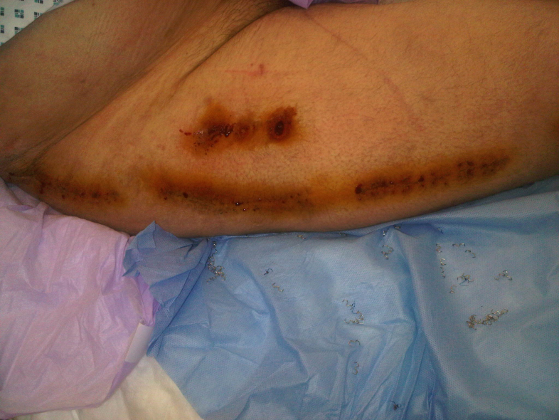
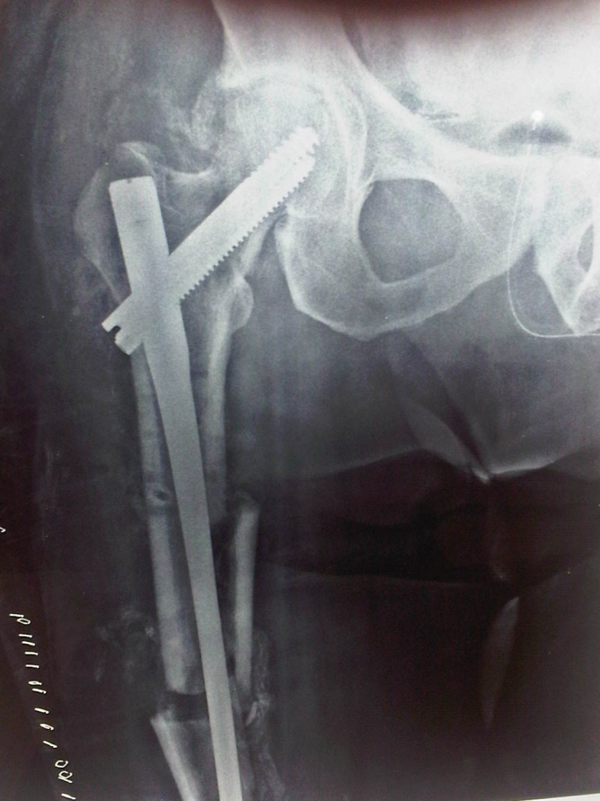
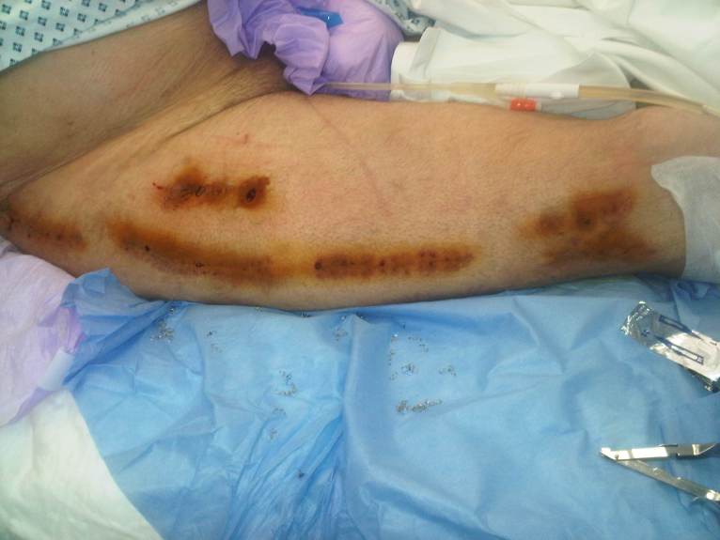
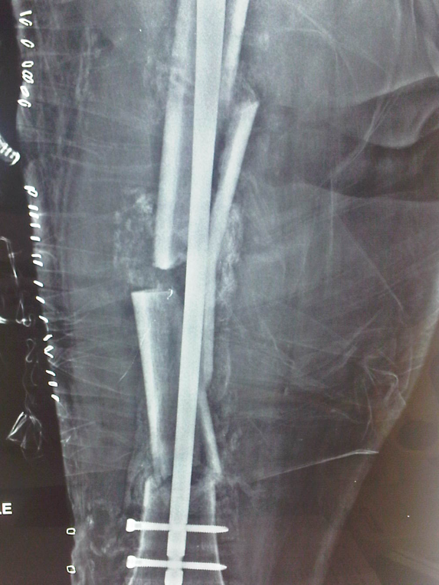

Slide 11
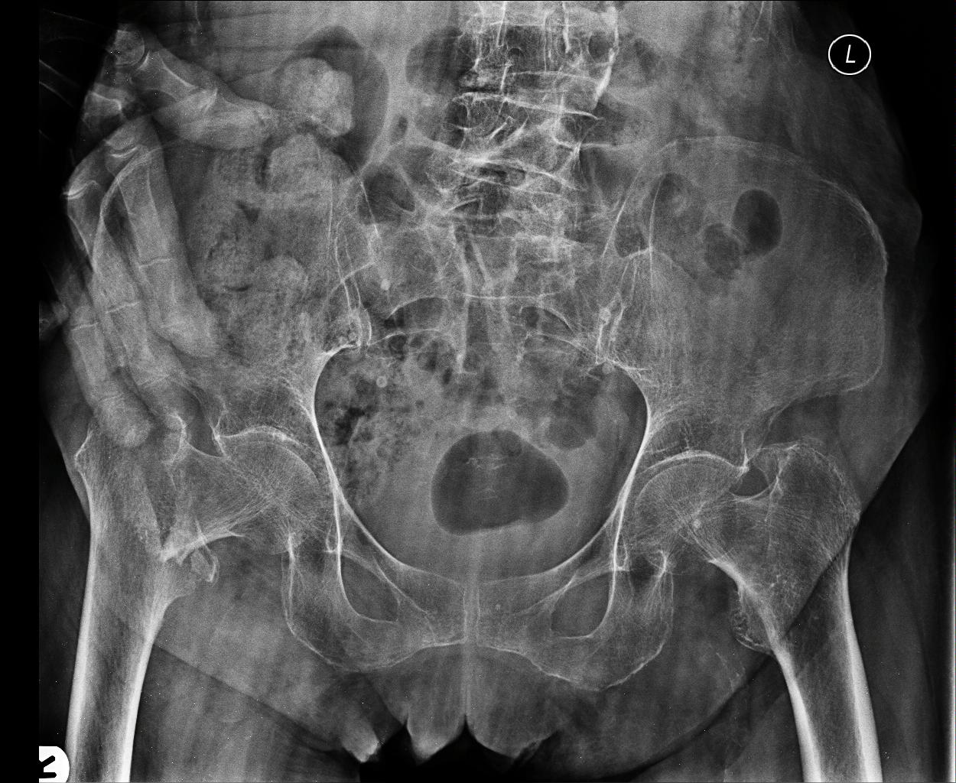
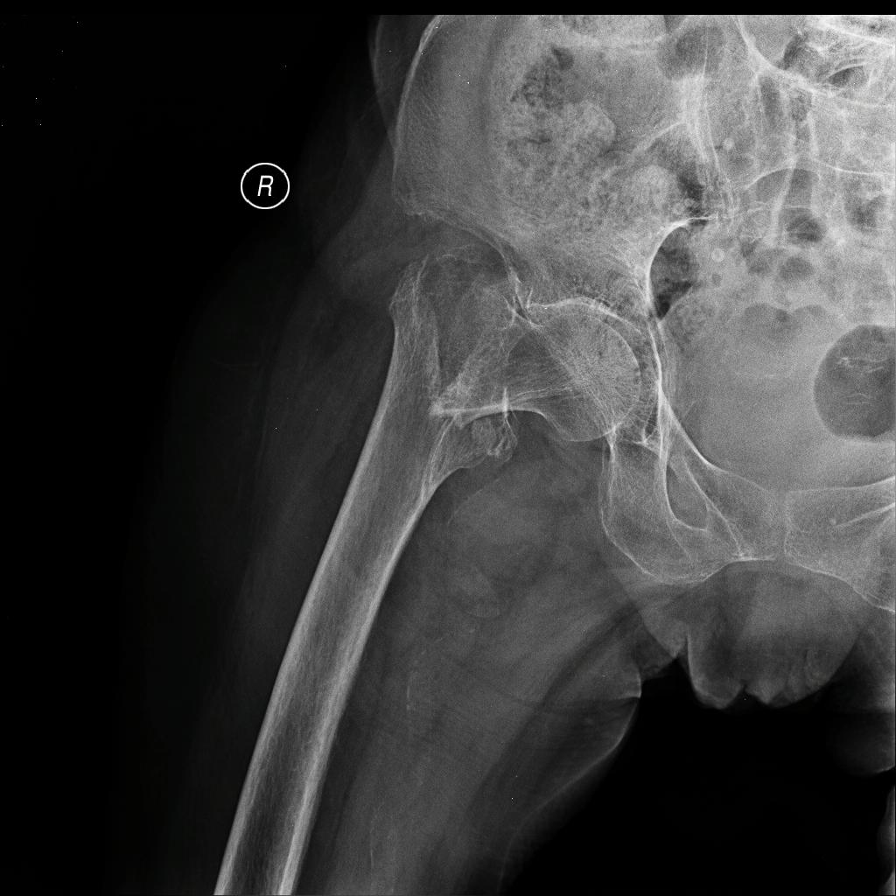

Slide 12
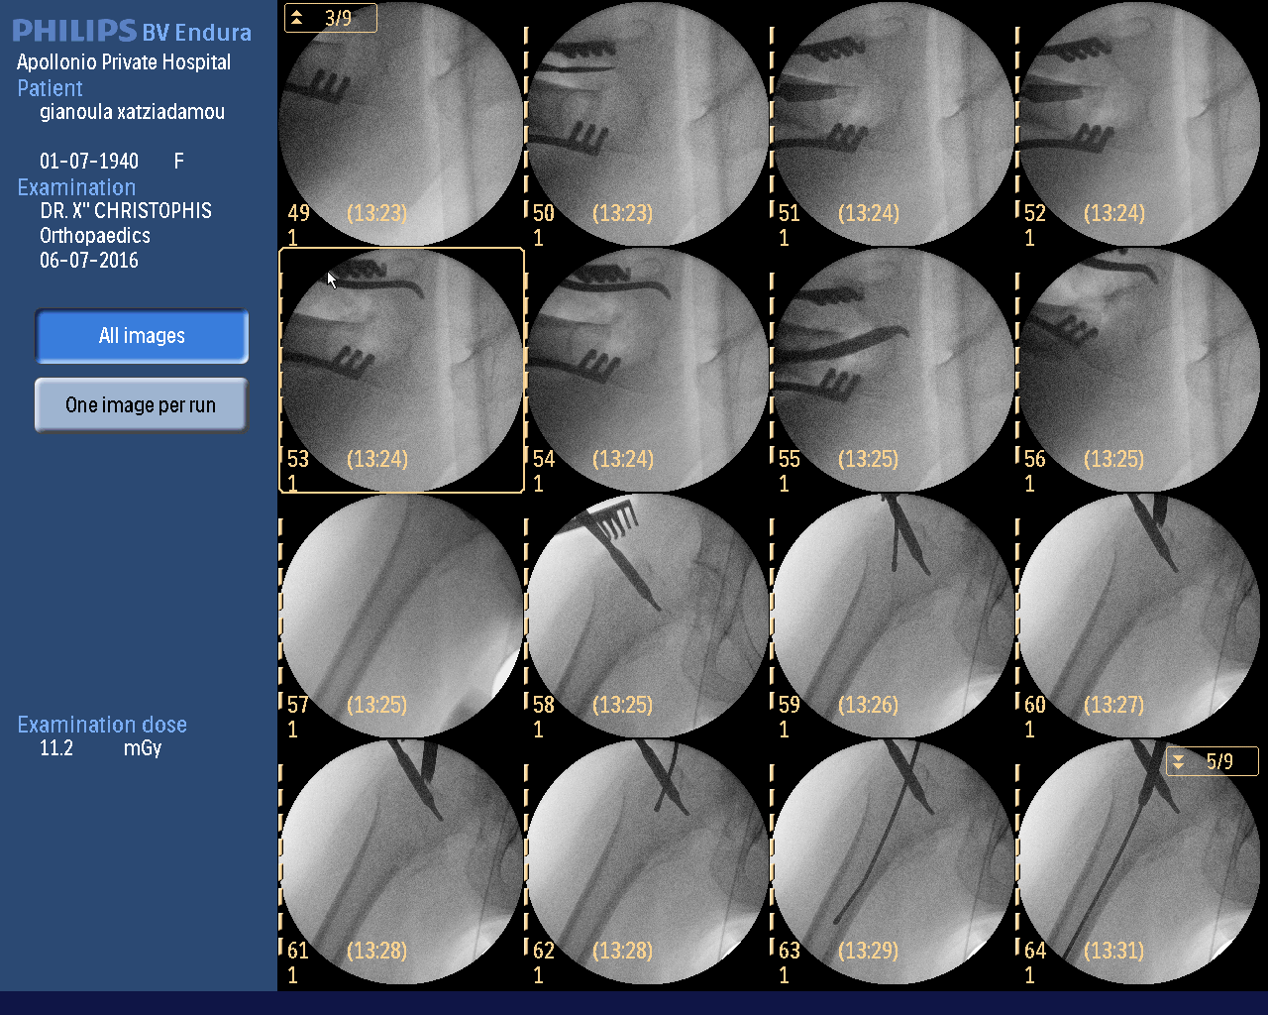
Note the displacement of the fracture on the lateral view and the reduction with the Hoffman. The positioning of the patient and reduction of the patient before the start of the procedure is very important.

Slide 13
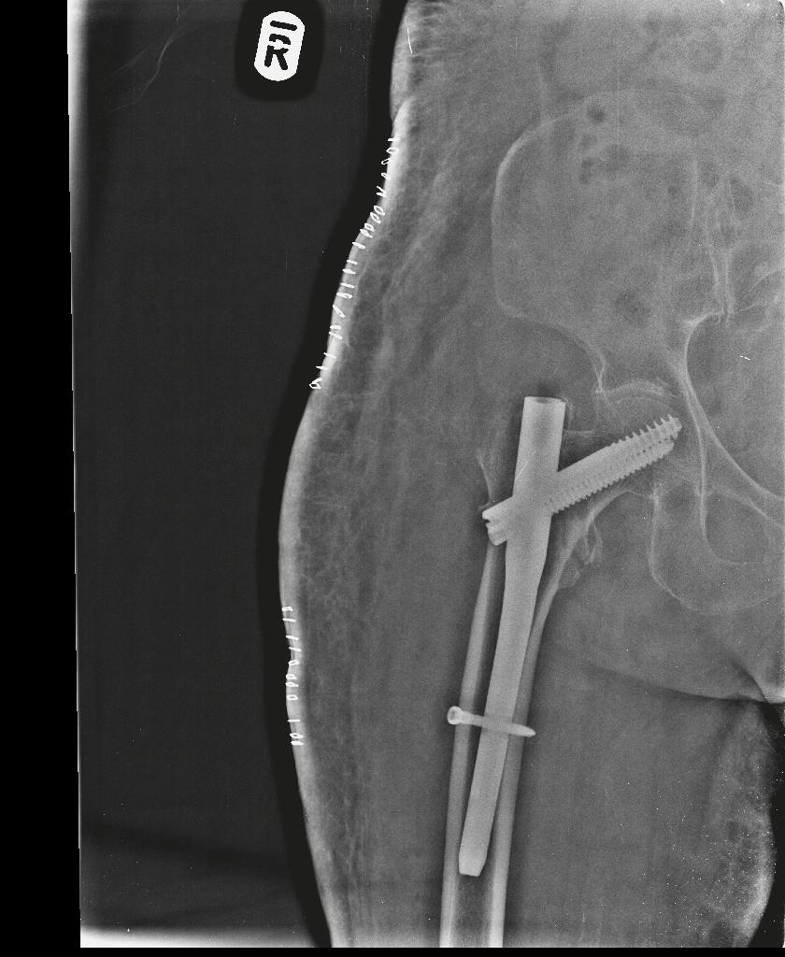


Slide 14
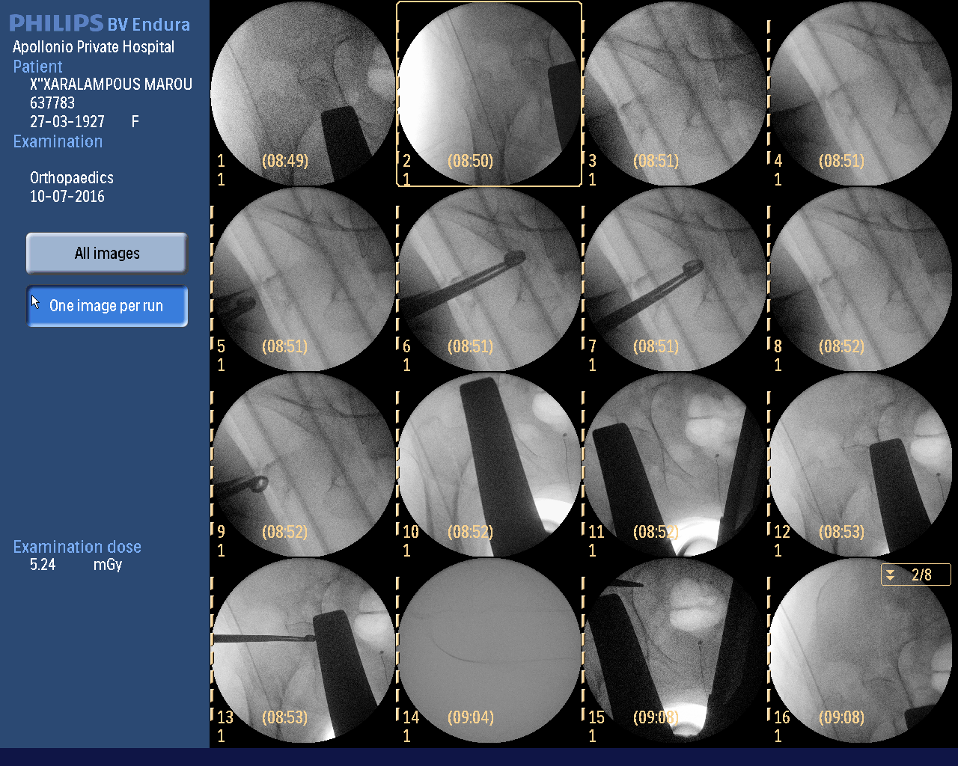
Accurate reduction before the procedure starts is very important

Slide 15
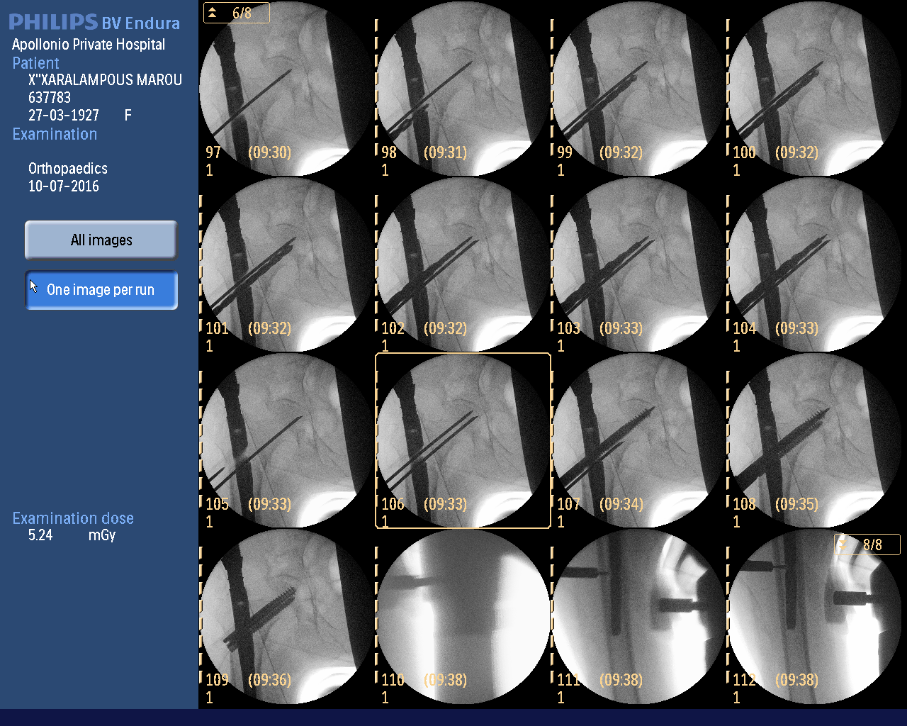
The stages in the insertion of the nail and the screws.

Slide 16
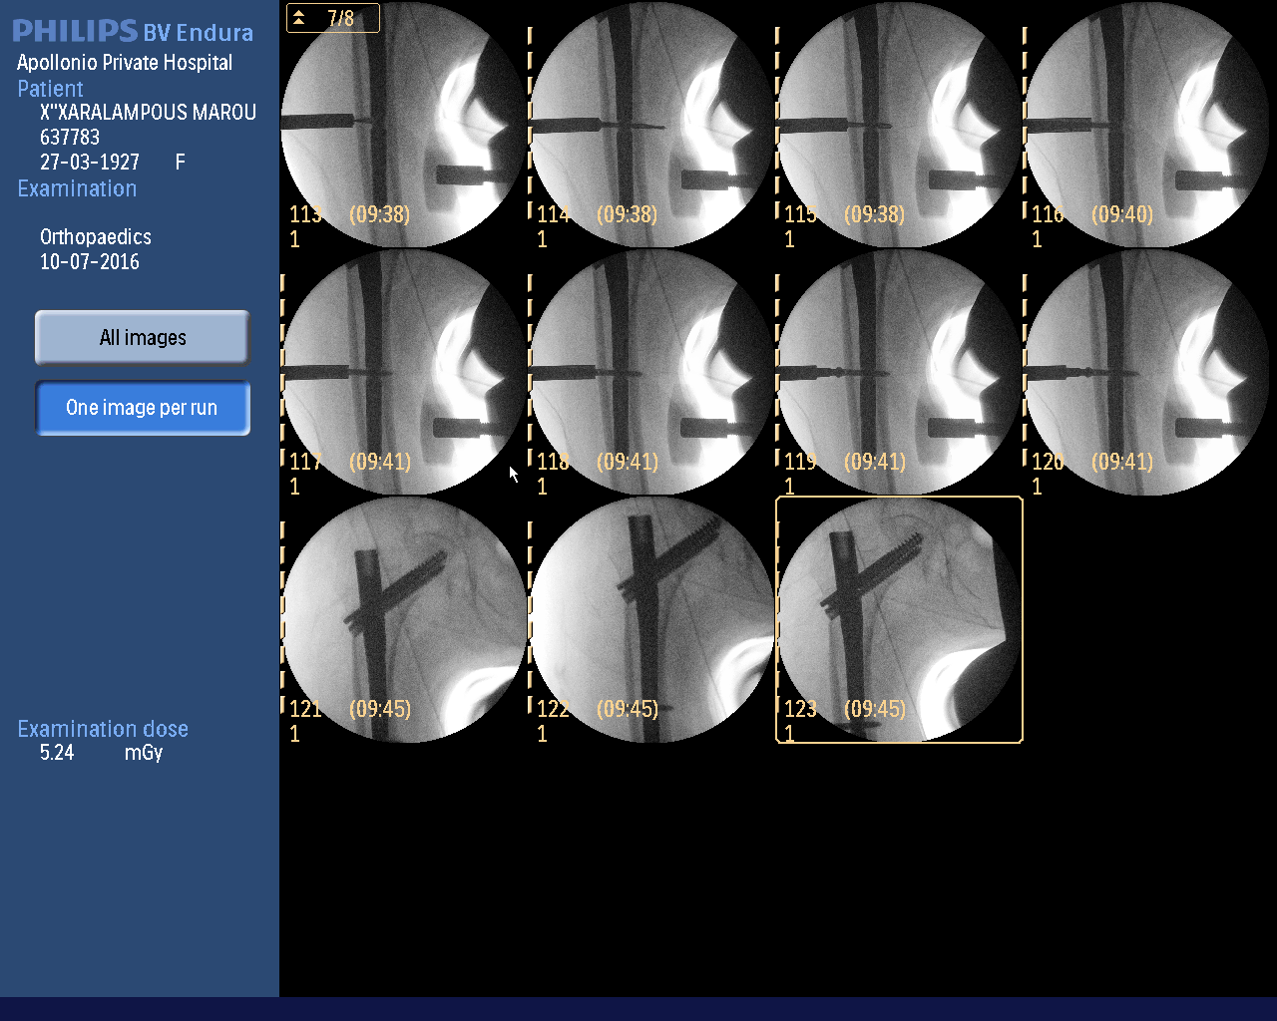
Final insertion of the nail and , proximal interlocking screws and distal screw.

Slide 17
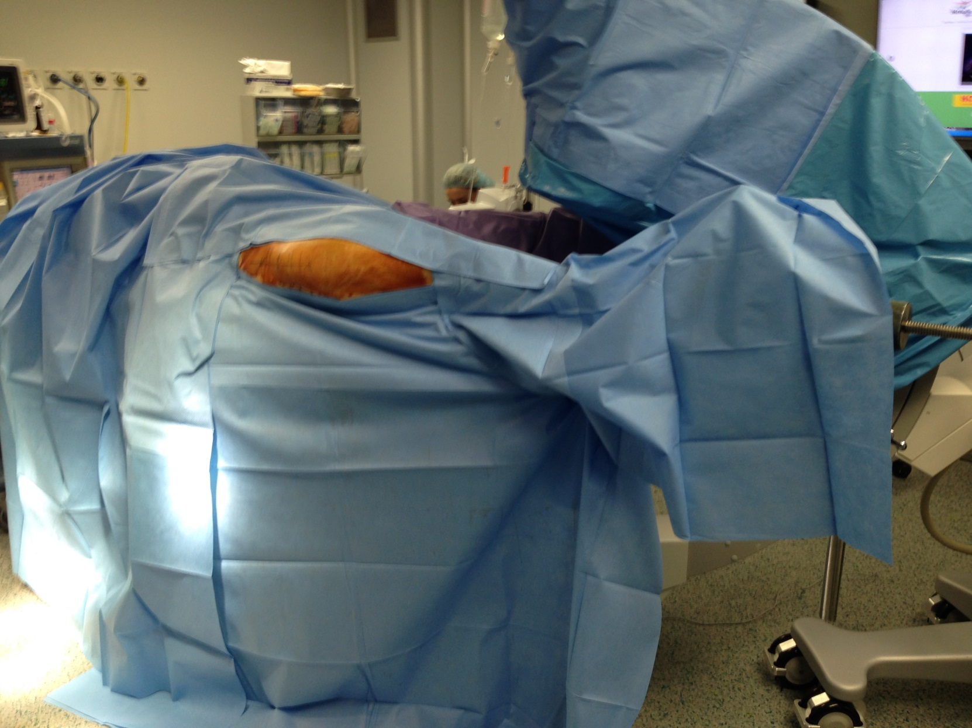
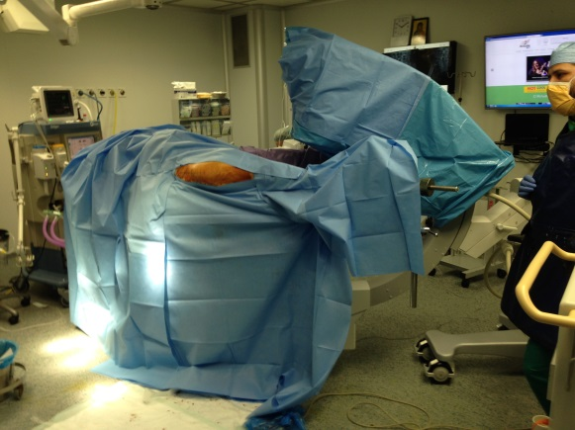
Positioning of the patient and reduction of
the fracture before the start of the procedure.

Slide 18
Original article - The Treatment of Intertrochanteric Fractures: Results using an Intramedullary Nail with Integrated Cephalocervical screws and Linear Compression
Andreas H Ruecker, MD, M. Rupprecht MD and co - Concluded:
The combbination of
2 intergrated screws using a worm gear mechanism to achieve linear compression
An intramedullary implant with a trapezoid proximal stem
A large (15,5mm) oval footprint within the head and neck fragment and
Maintenance of intraoperative reduction during implant insertion
All have improved the fixation of intertrochanteric fractures by preventing uncontrolled collapse through rotation

Slide 19
Intertrochanteric and Subtrochanteric Fractures
Personal experience Using INTERTAN - an Intramedullary Reconstruction Nail
CONCLUSION
The InterTan device appears to be a reliable implant for the treatment of complicated peritrochanteric and segmental femoral fractures.
Its design provides for stability against rotation and minimizes neck malunions (shortening) through linear intraoperative compression of the head/neck segment to the shaft.
I believe this devise is giving an extra dimension in the femoral intramedullary fixation

Slide 20

Thank you

