Slide 1
Question 1

Slide 2
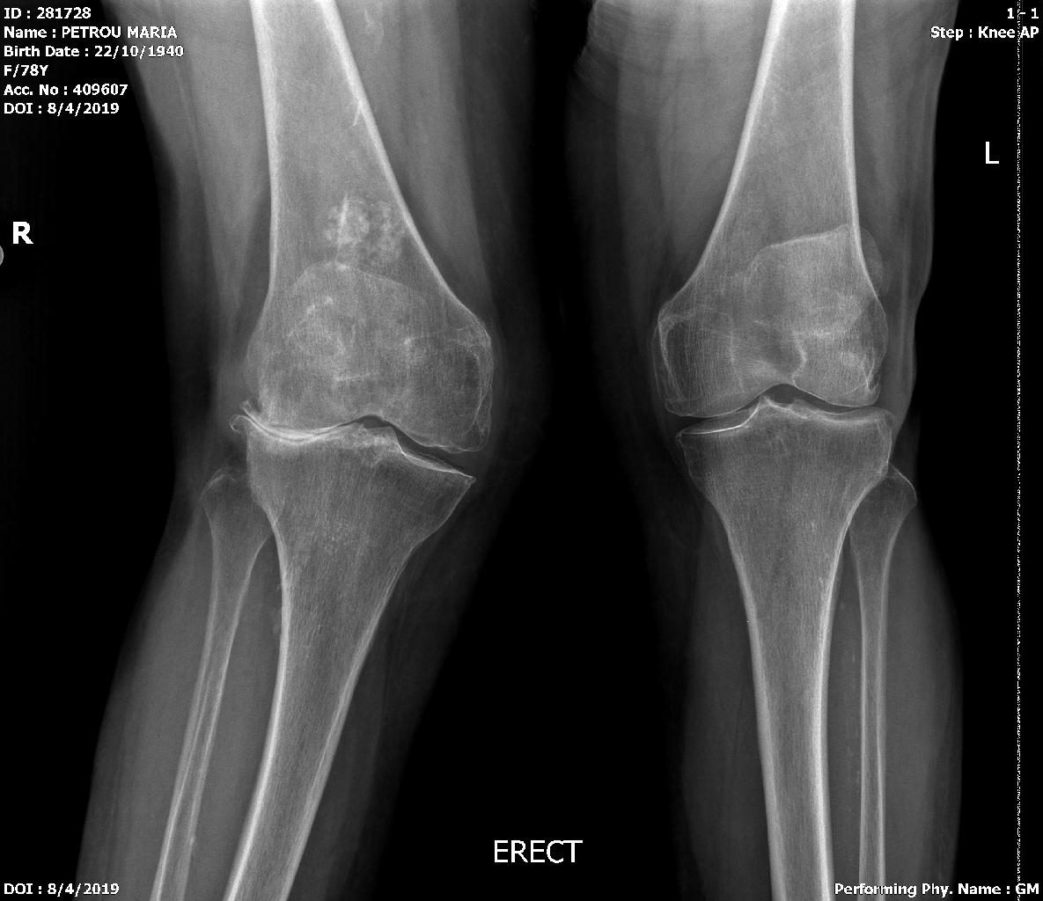
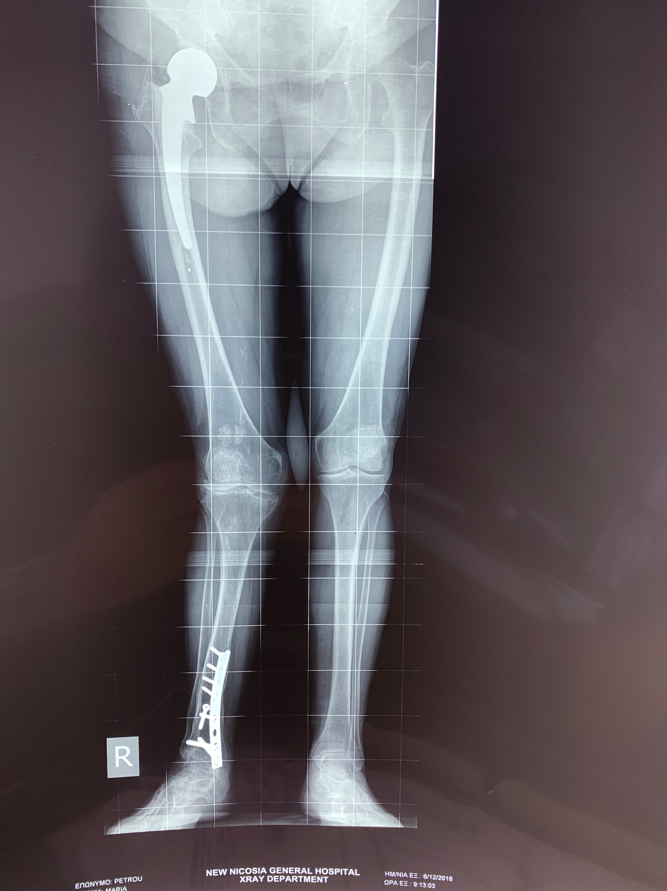
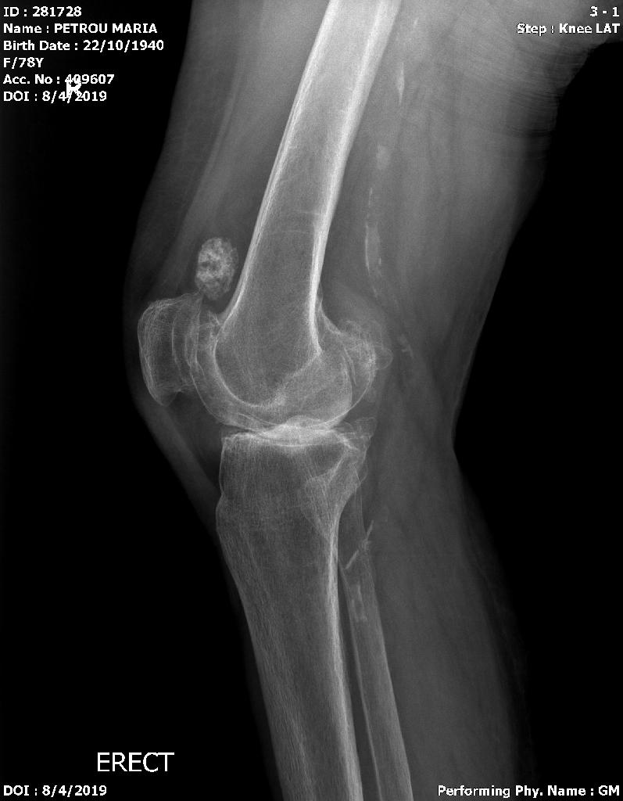
Severe Genu valgus Right knee.
79 years old. Active.
Leg in external rotation after Hemiarthroplasty.
On examination valgus deformity not correctable

Slide 3
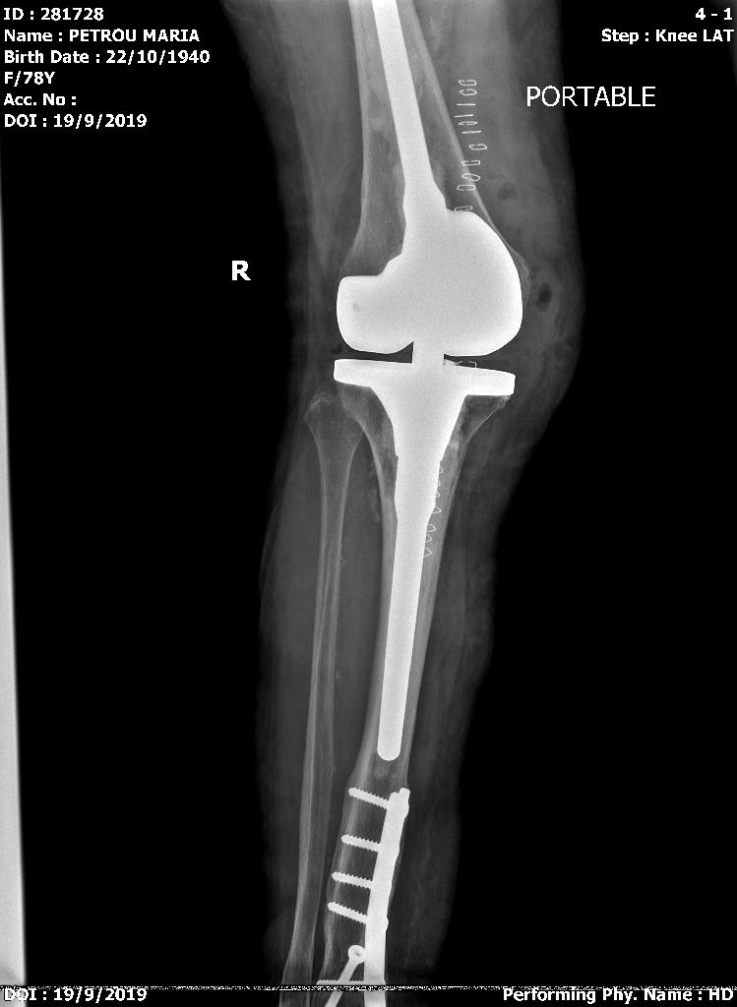
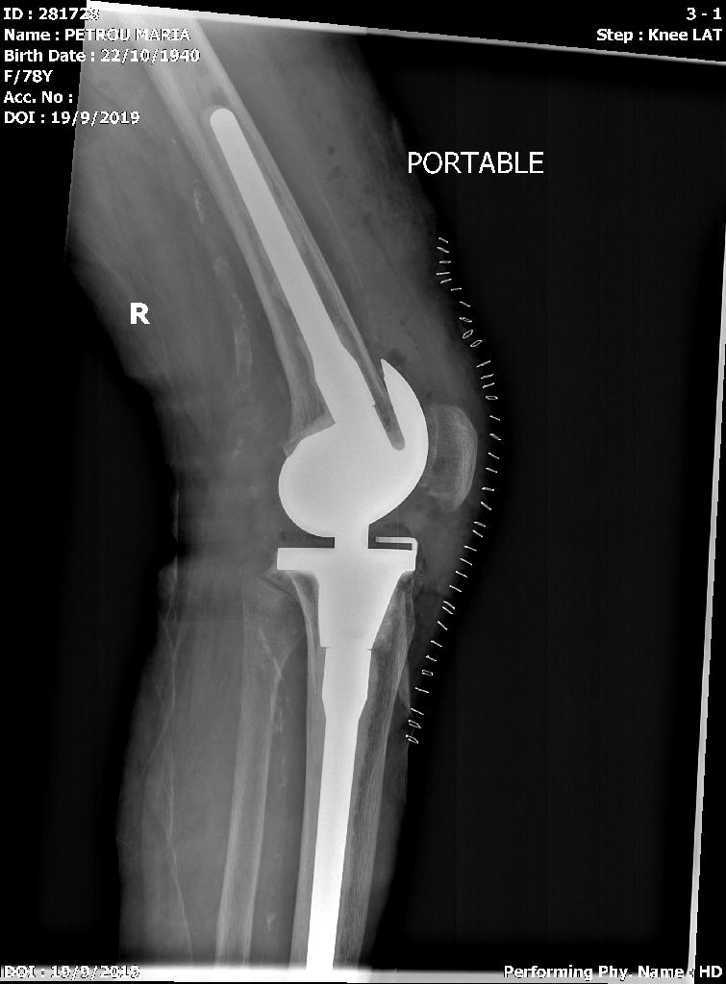

Slide 4
Question 2

Slide 5
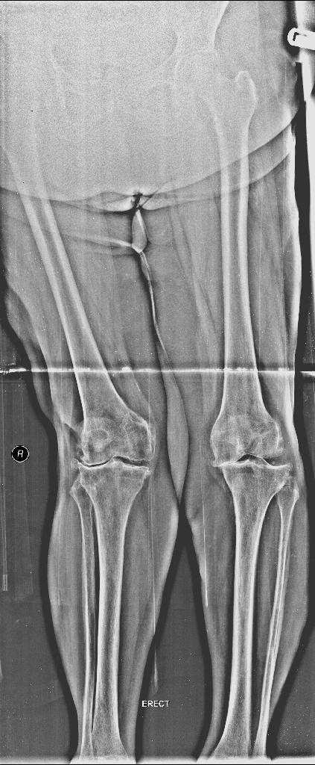
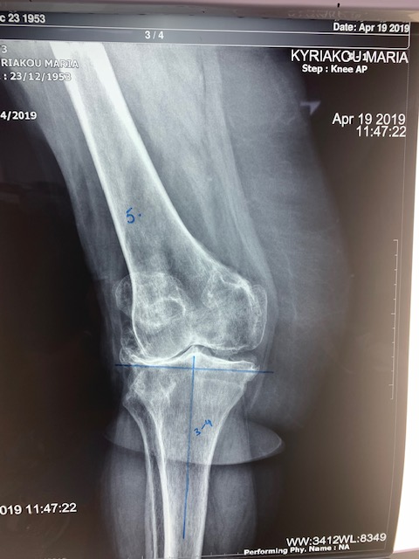
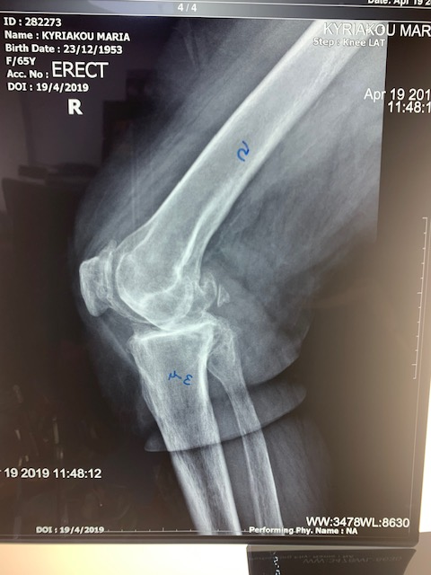
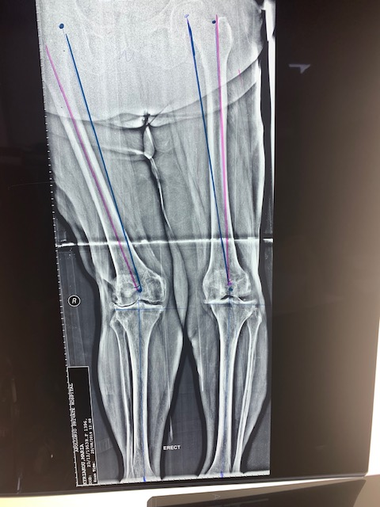
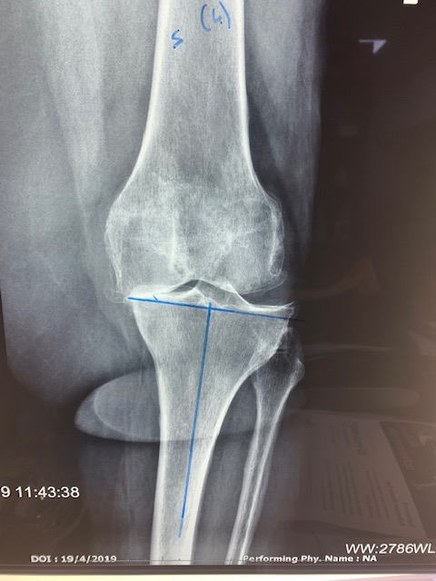
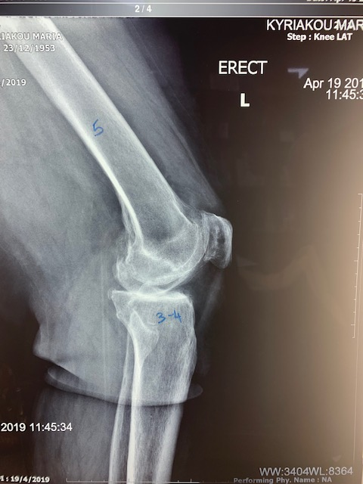
Destructive arthritis bilateral. Genu Valgus right.
65 years old. Well. Active.
On examination correctable valgus deformity.

Slide 6
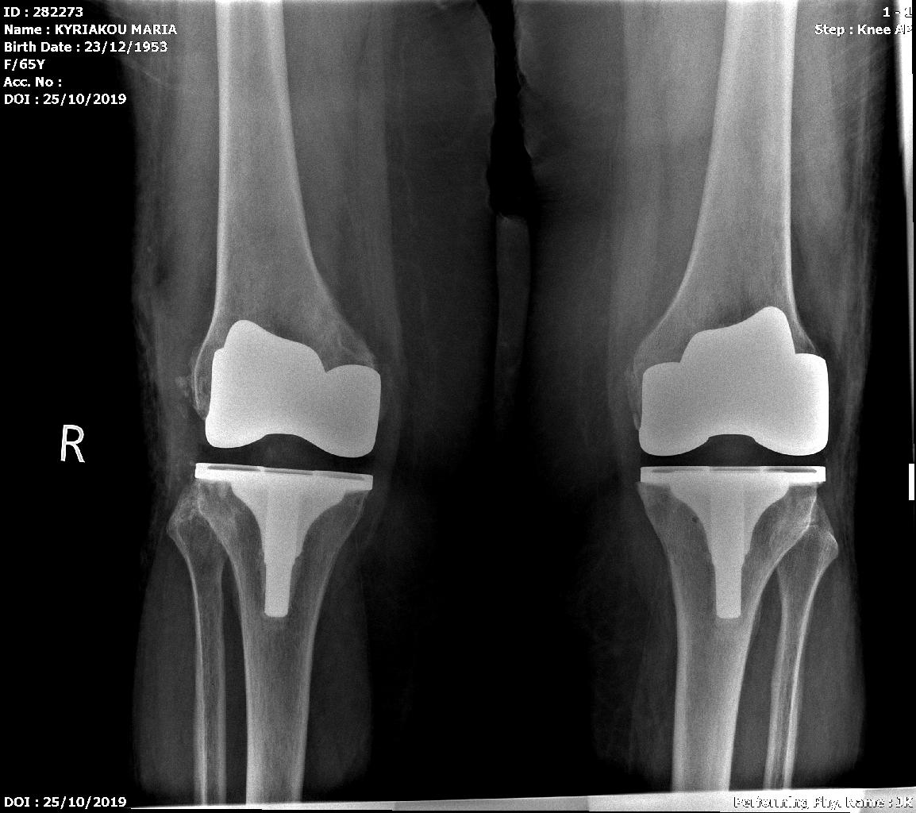
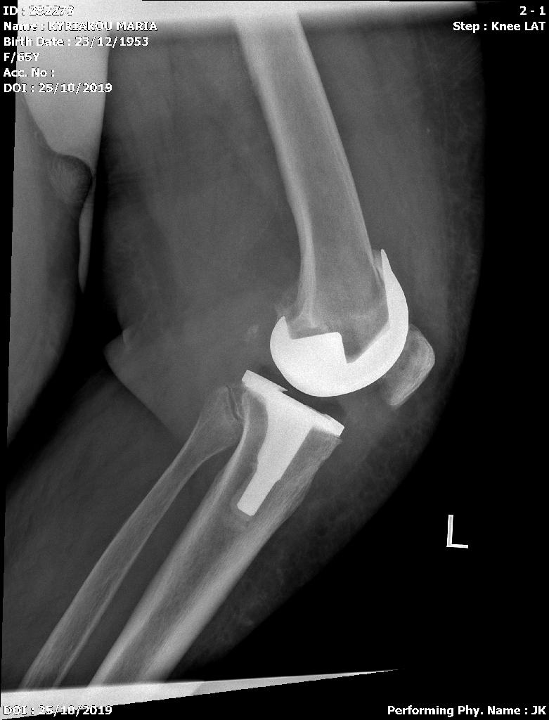
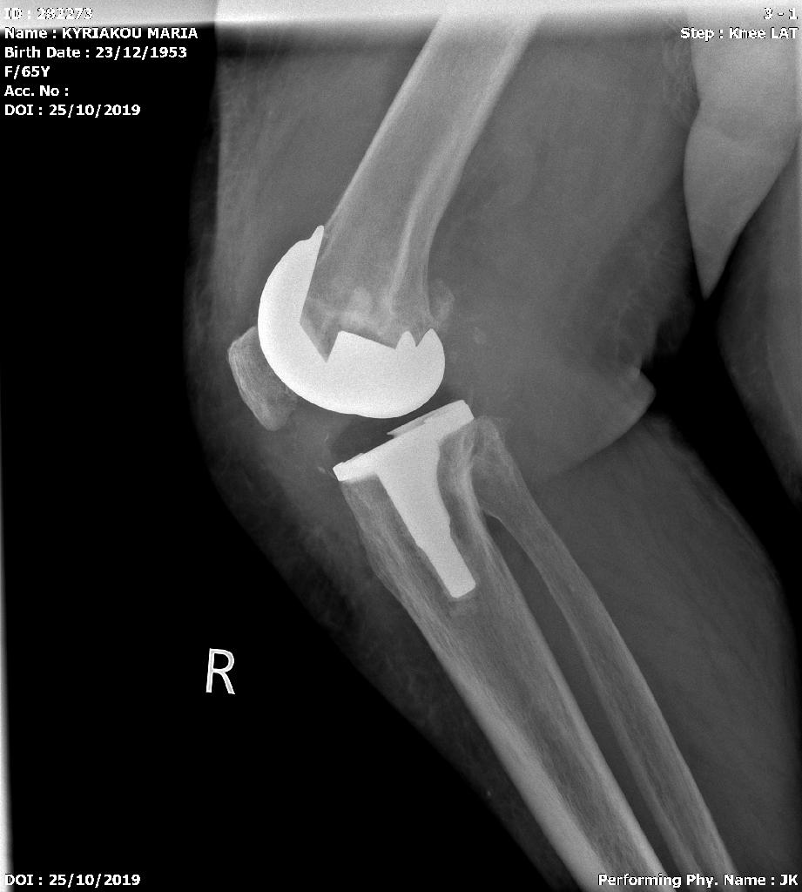

Slide 7
Question 3
Very Severe Varus Knees

Slide 8
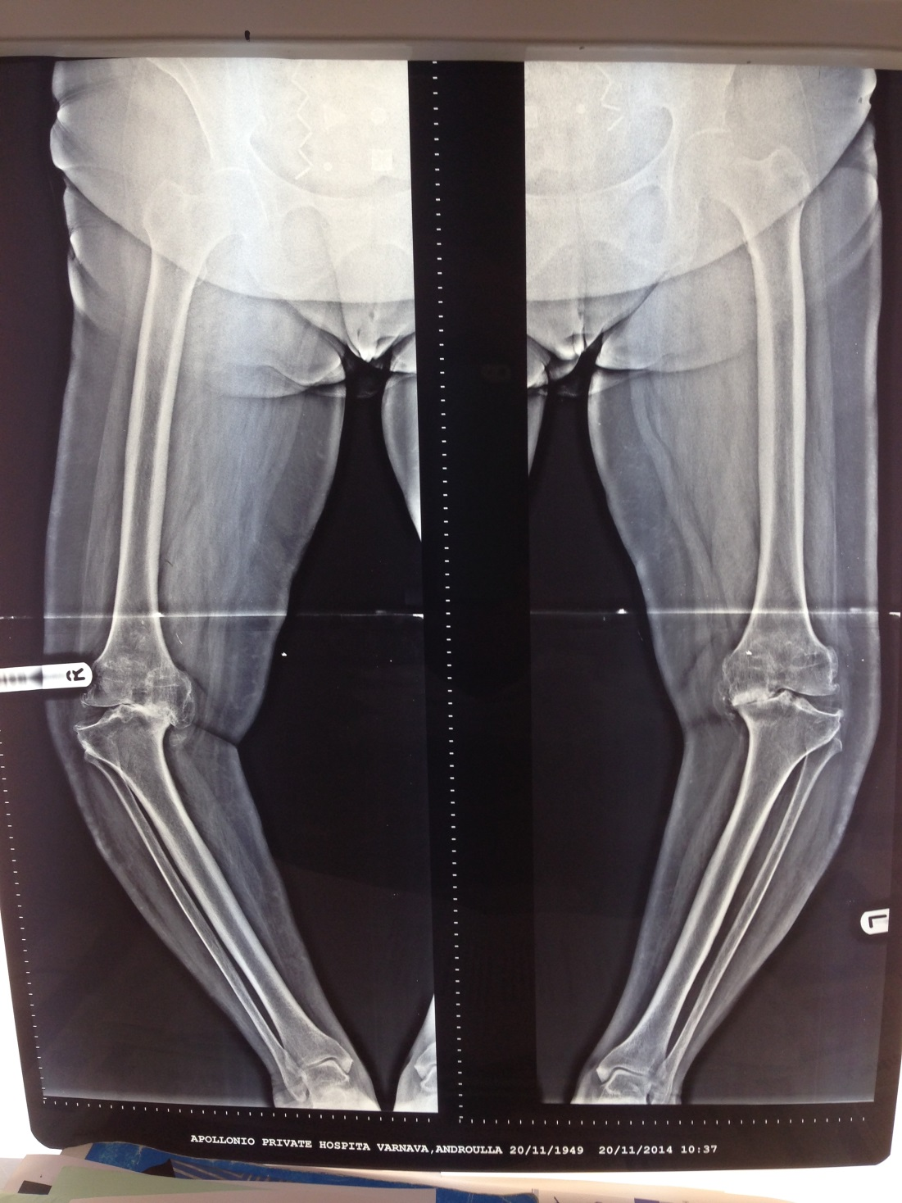
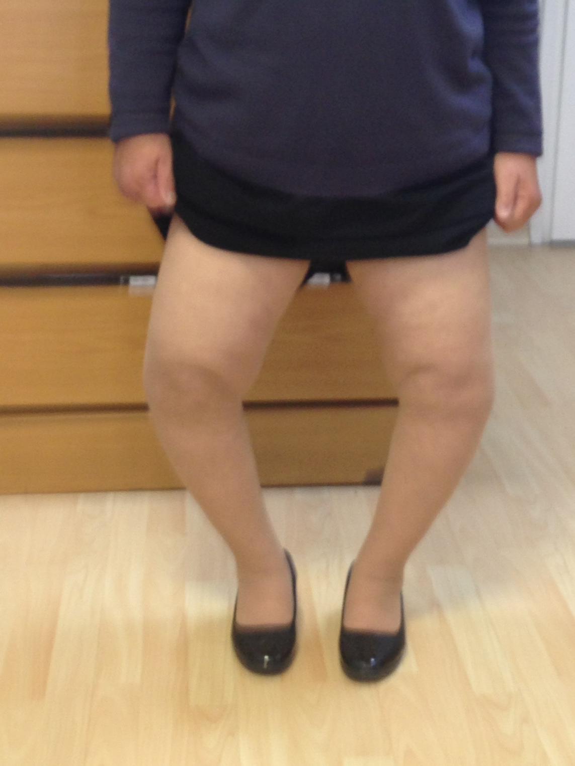

Slide 9
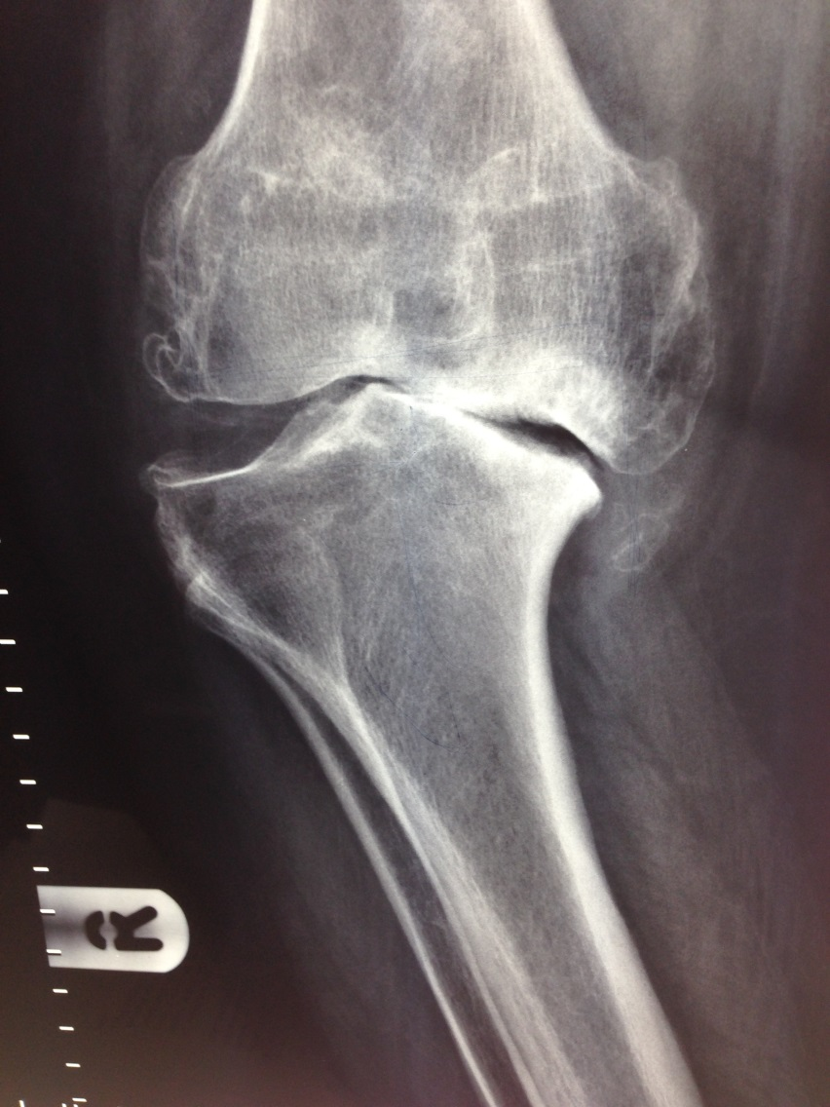
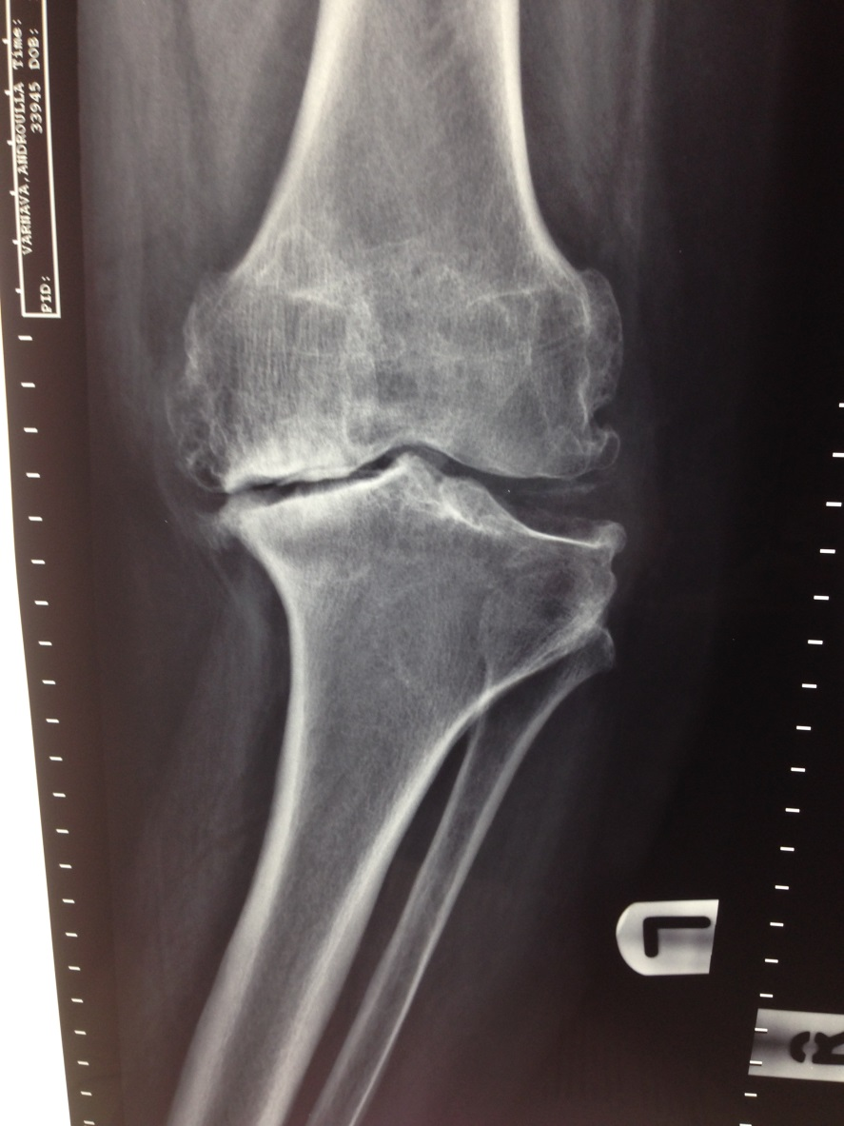

Slide 10
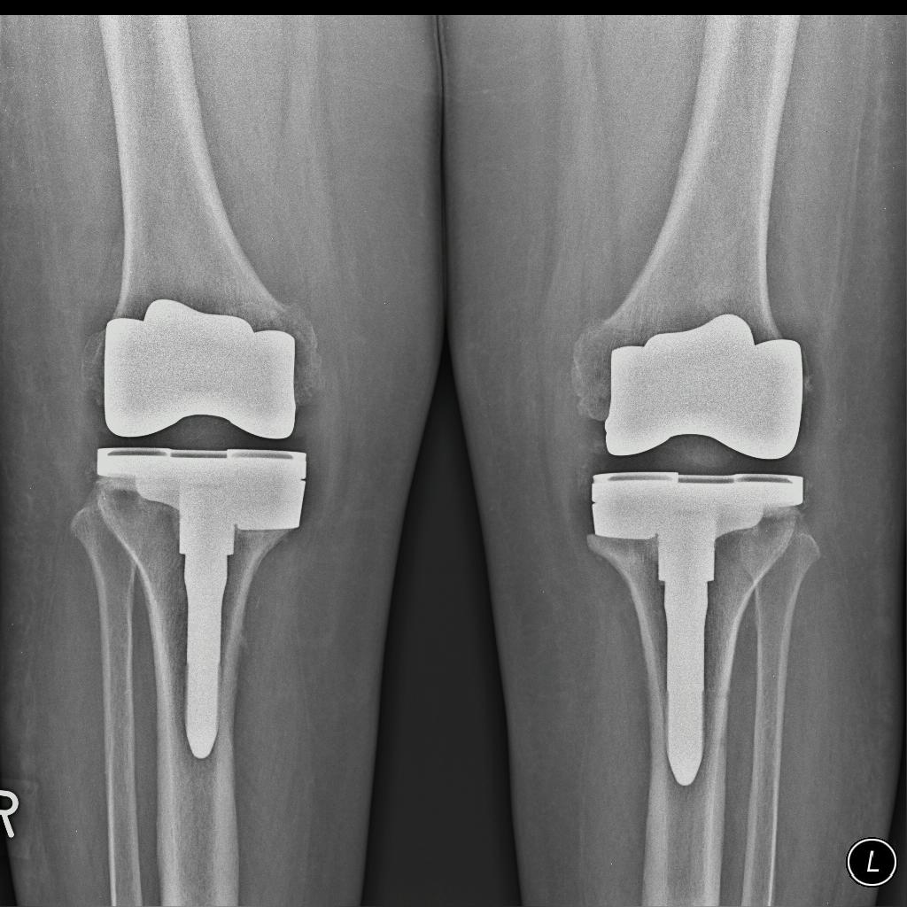
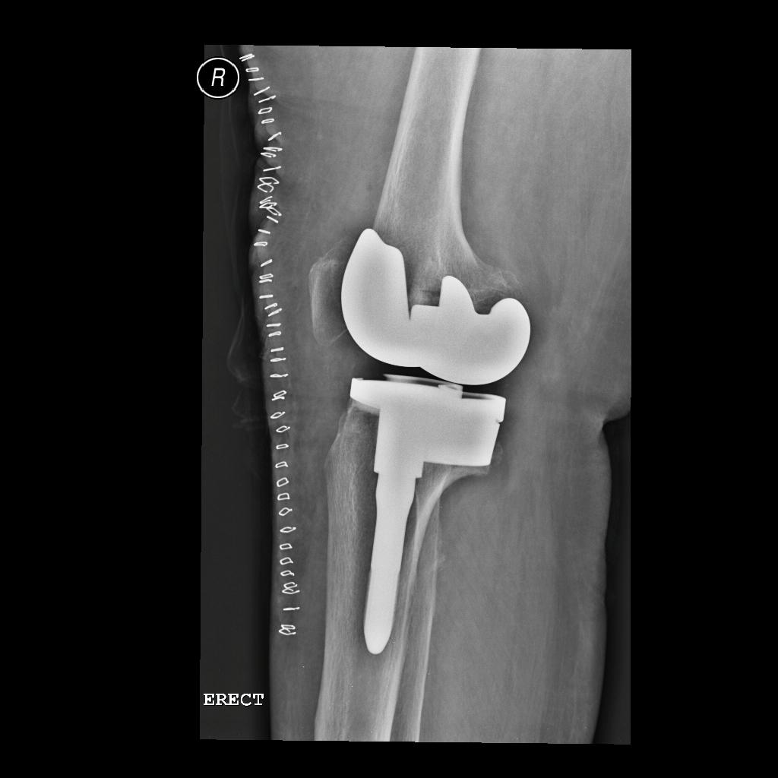
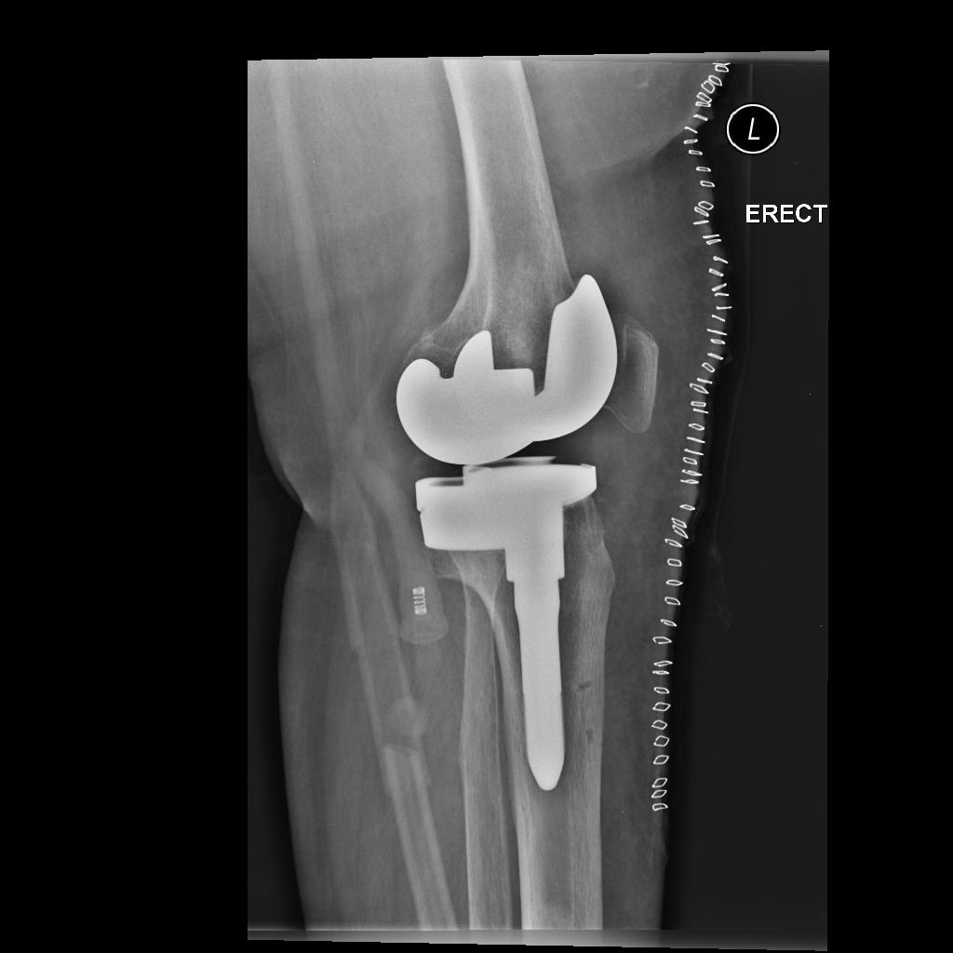

Slide 11
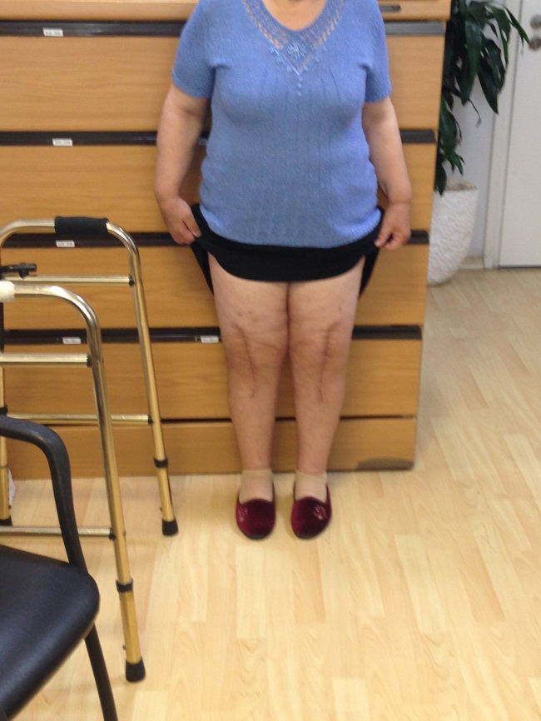



Slide 12
Question 4

Slide 13
Question 4
Part 1
25 years old lady, psychiatric patient on medication after bad fracture of the Tibial plateau and ORIF developed severe infection in the knee joint and bone.

Slide 14
Question 4
Part 2
After 2 operations in Germany – debridement where
the peroneal nerve was injured (drop foot)
they performed Total knee Replacement.
Never walked since fracture …
Infections… antibiotics… ...4 years - worse
→

Slide 15
Question 4
Part 3
She never walked after surgery. Severe infection.
Sent to Medical committee → specialist unit
They performed a HUGE REVISION surgery (old constraint implant)
Never walked.
6 months later severe infection (CRP 497)
Urgent surgery
Removal of implants. Most of the bone was replaced with cement!
About 12 cm femur, the shaft was split, about 3cm tibia the shaft was split!
What next → Structural allograft, ext. fixator …

