Slide 1
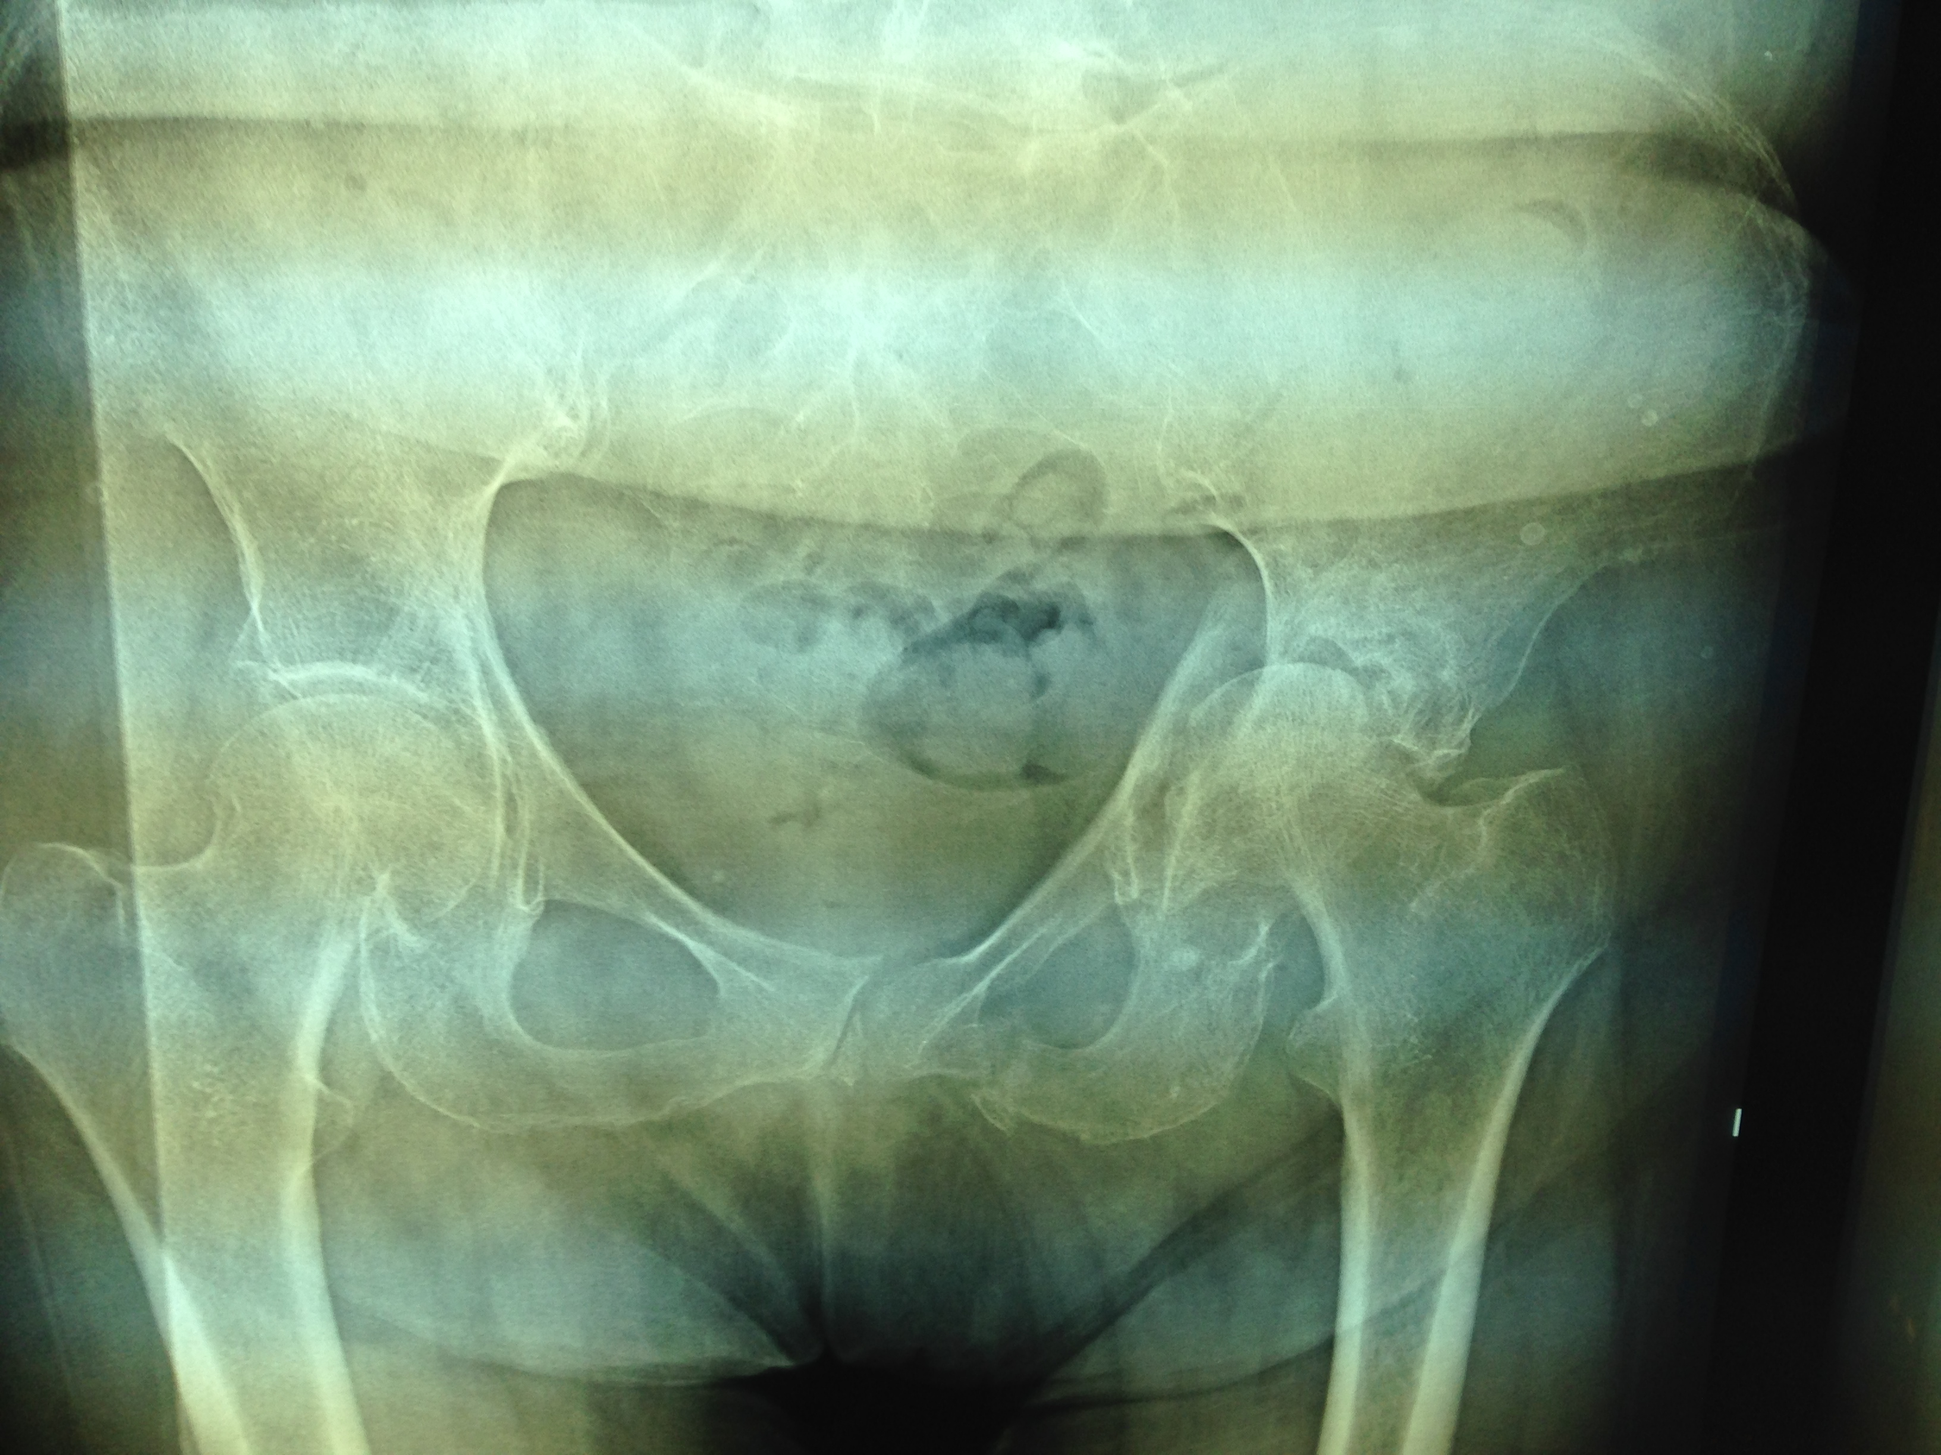
15/3/2013

Slide 2
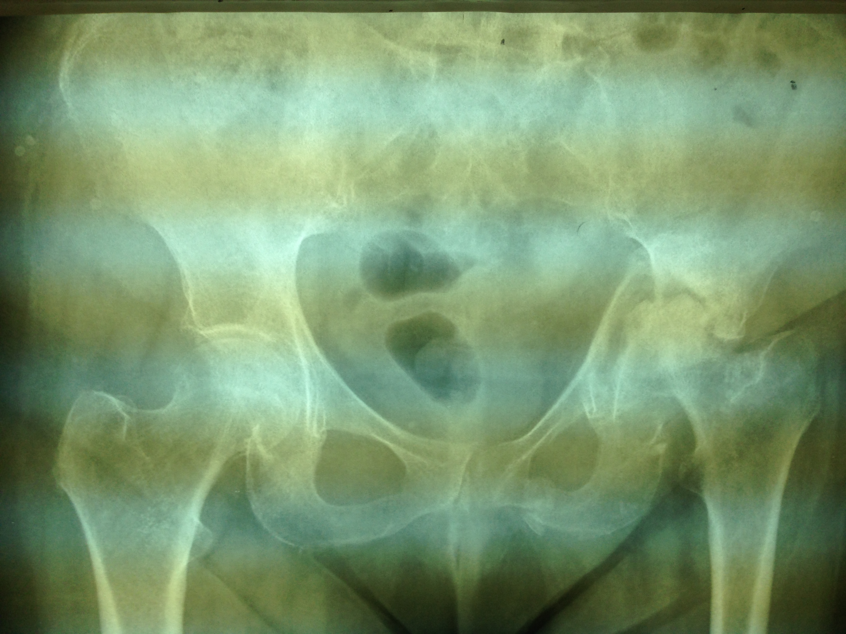
25/10/2013

Slide 3
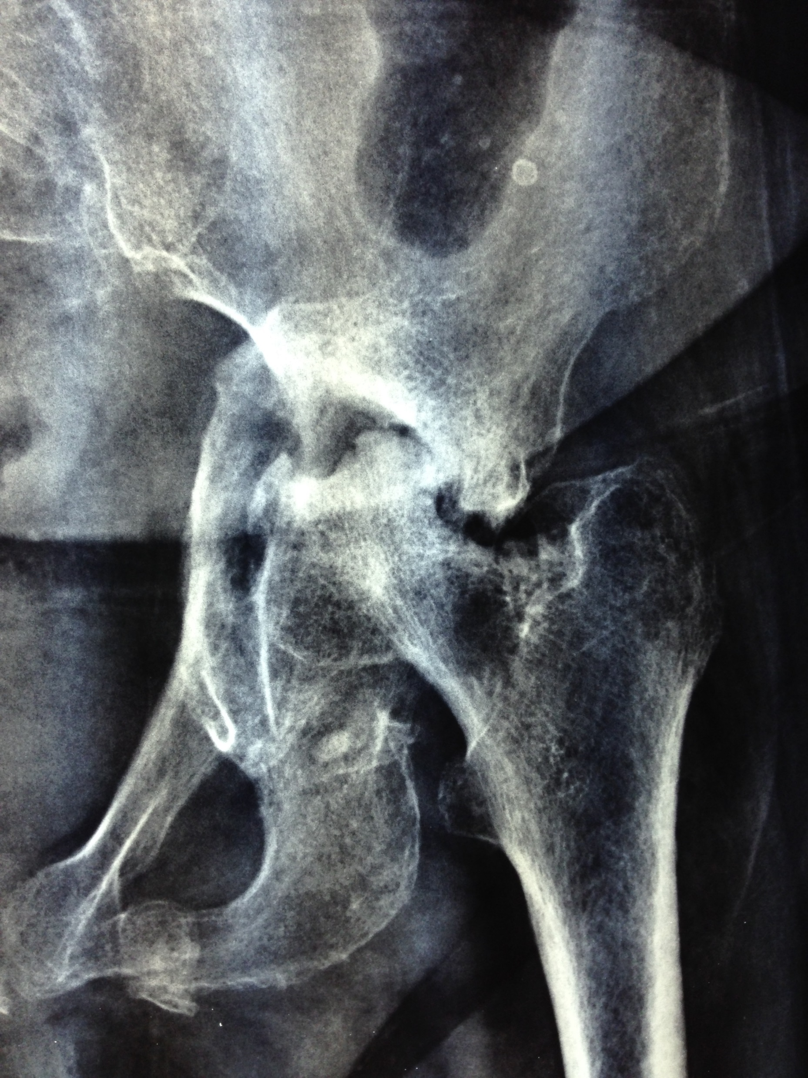
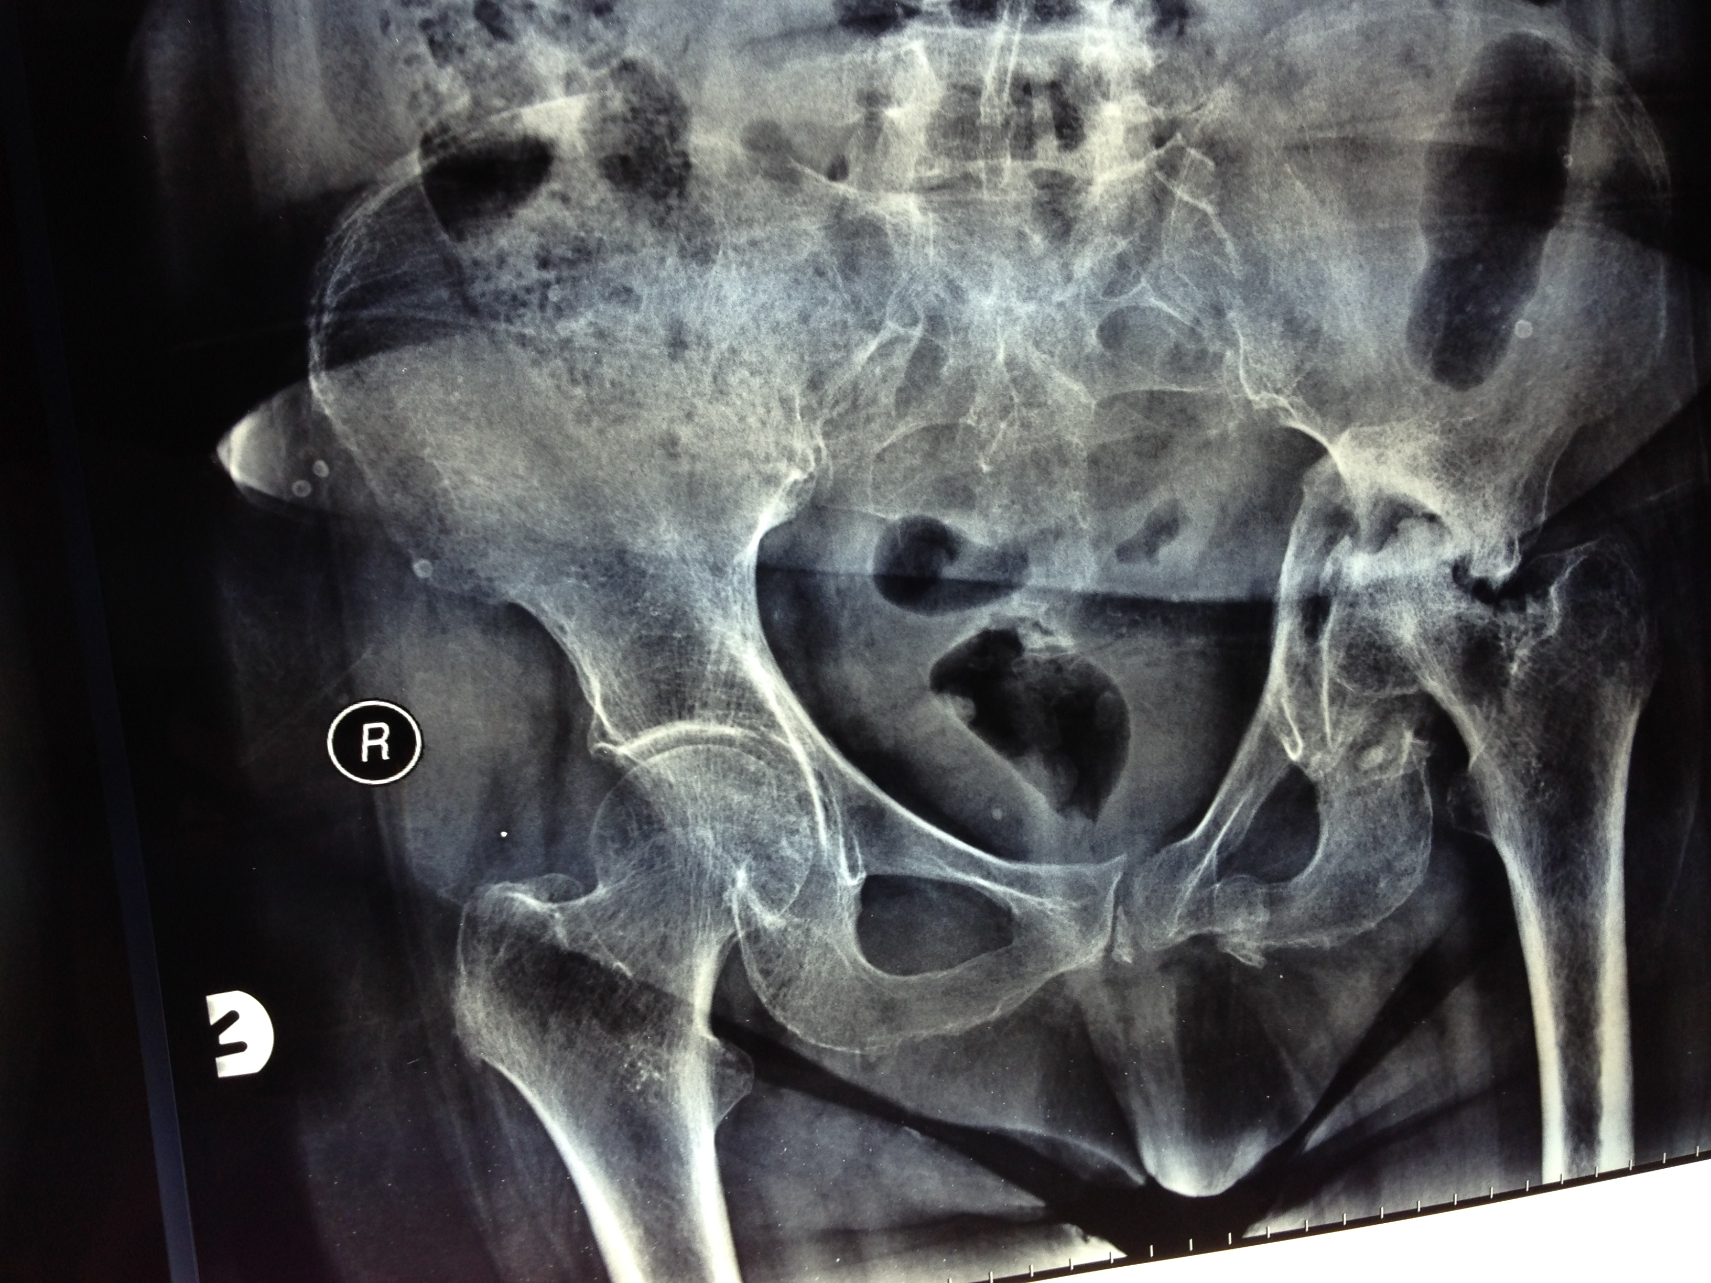
5/2/2014

Slide 4

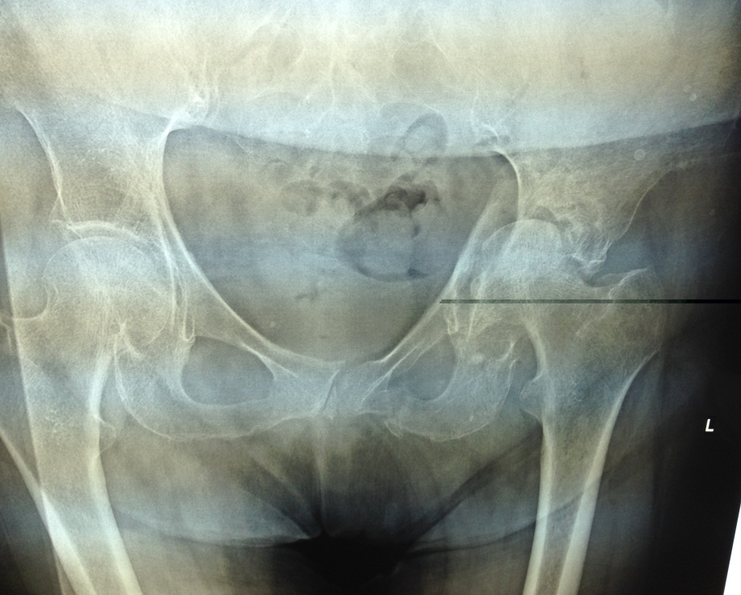
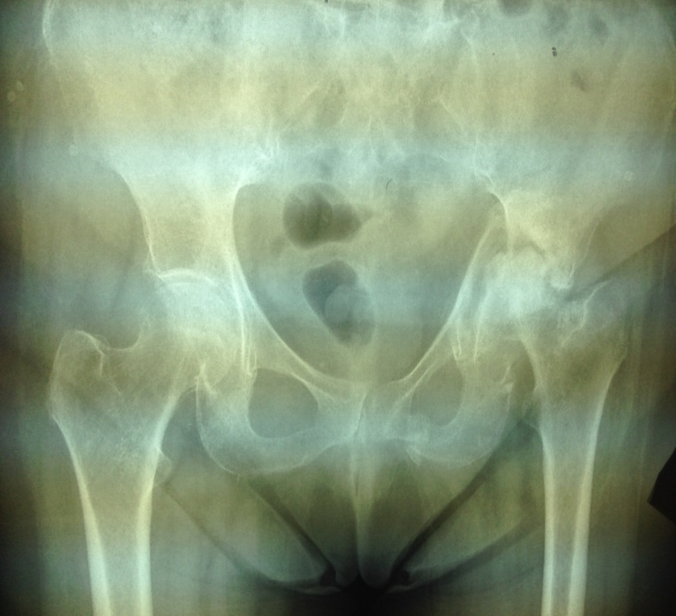
Frangou Kalomira . DOB 21/10/1930
5/2/2014
17/11/2012 Fell. Injury of the pelvis – fracture Left acetabulum
15/3/2013
25/10/2013
The deformity of the Hip joint is getting much worse over a period of 10 months. Soon she will not be able to walk and will be on a wheelchair. She needs urgent attention. Already there is substantial shortening and serious protrusio of the Hip joint. Total Hip Replacement as soon as possible is the only solution.

Slide 5
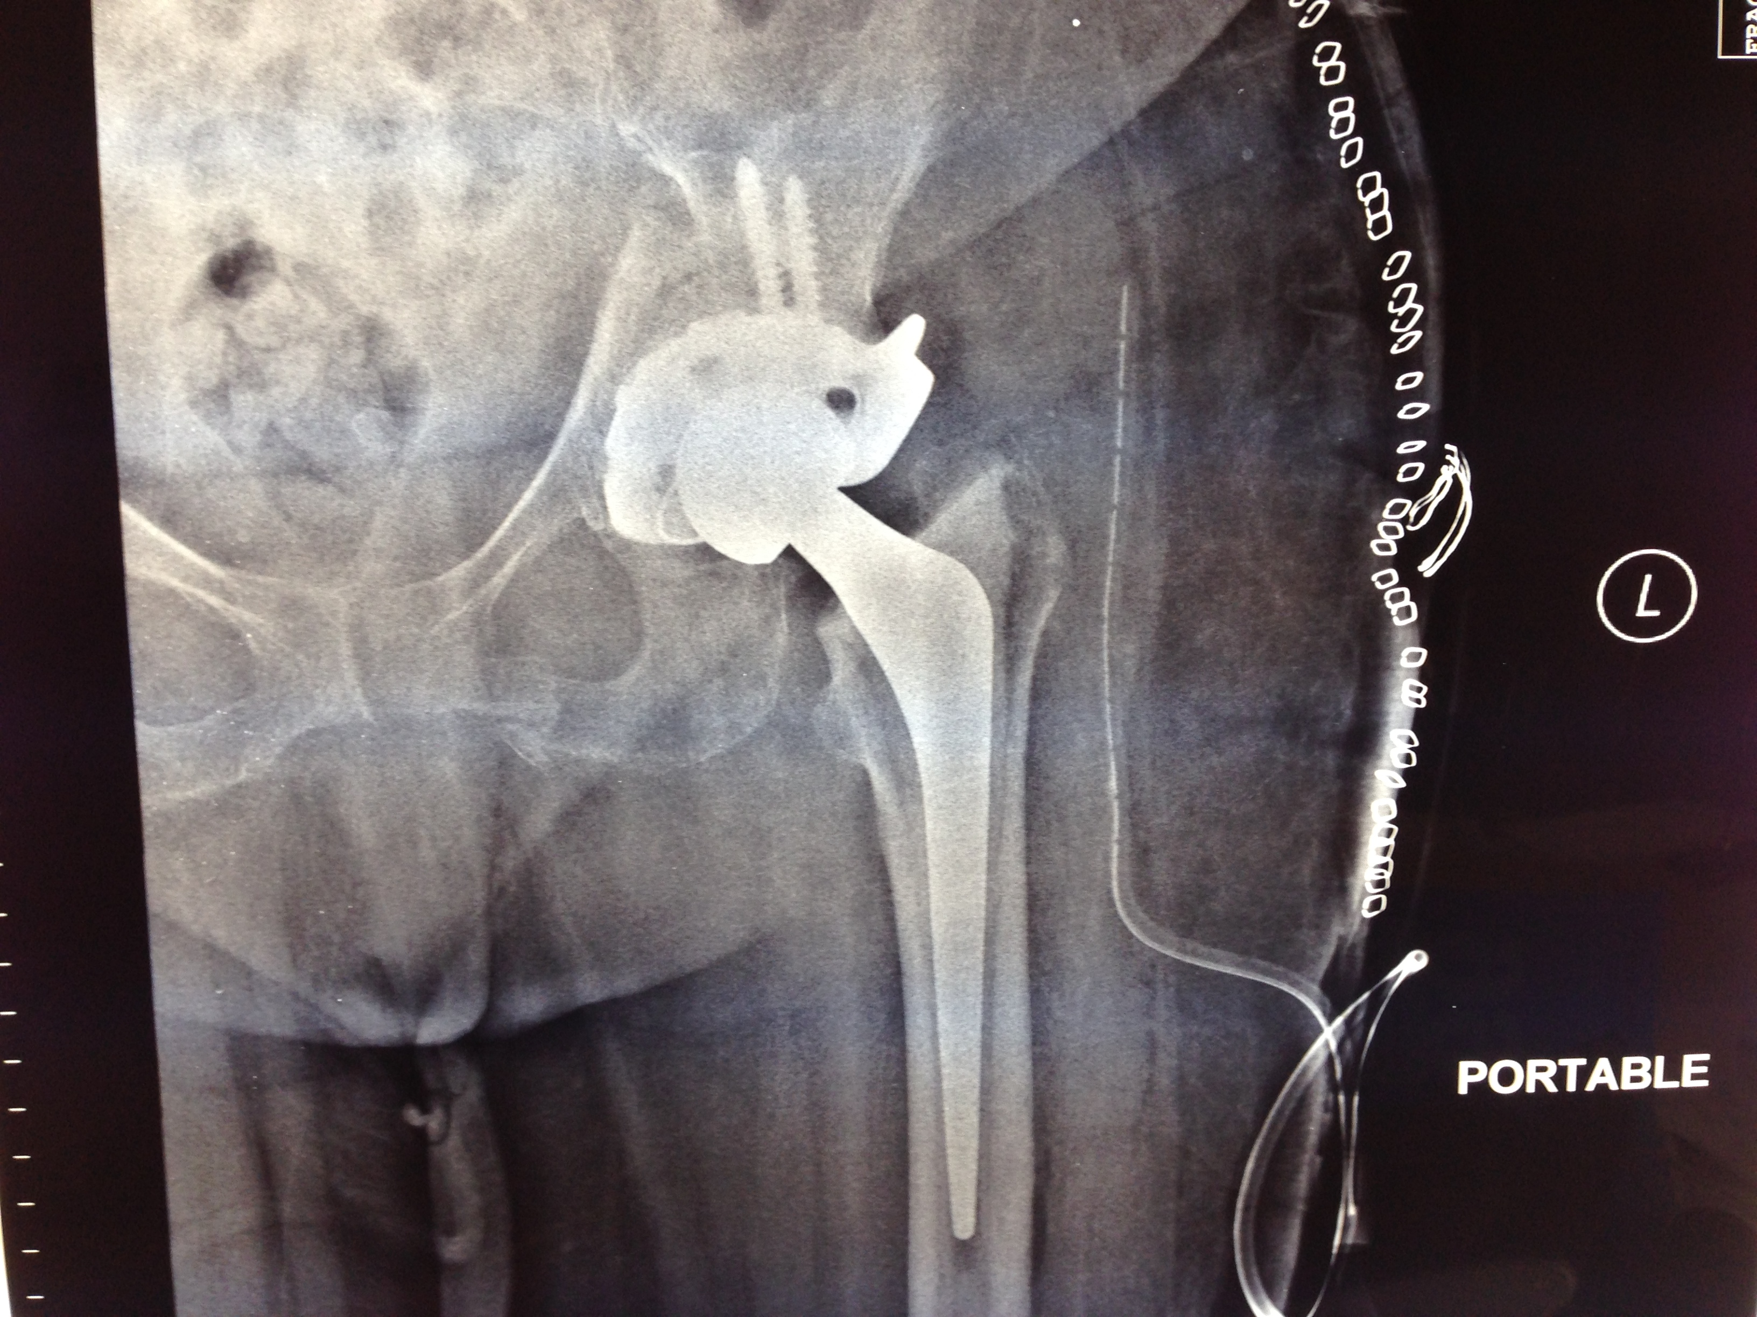
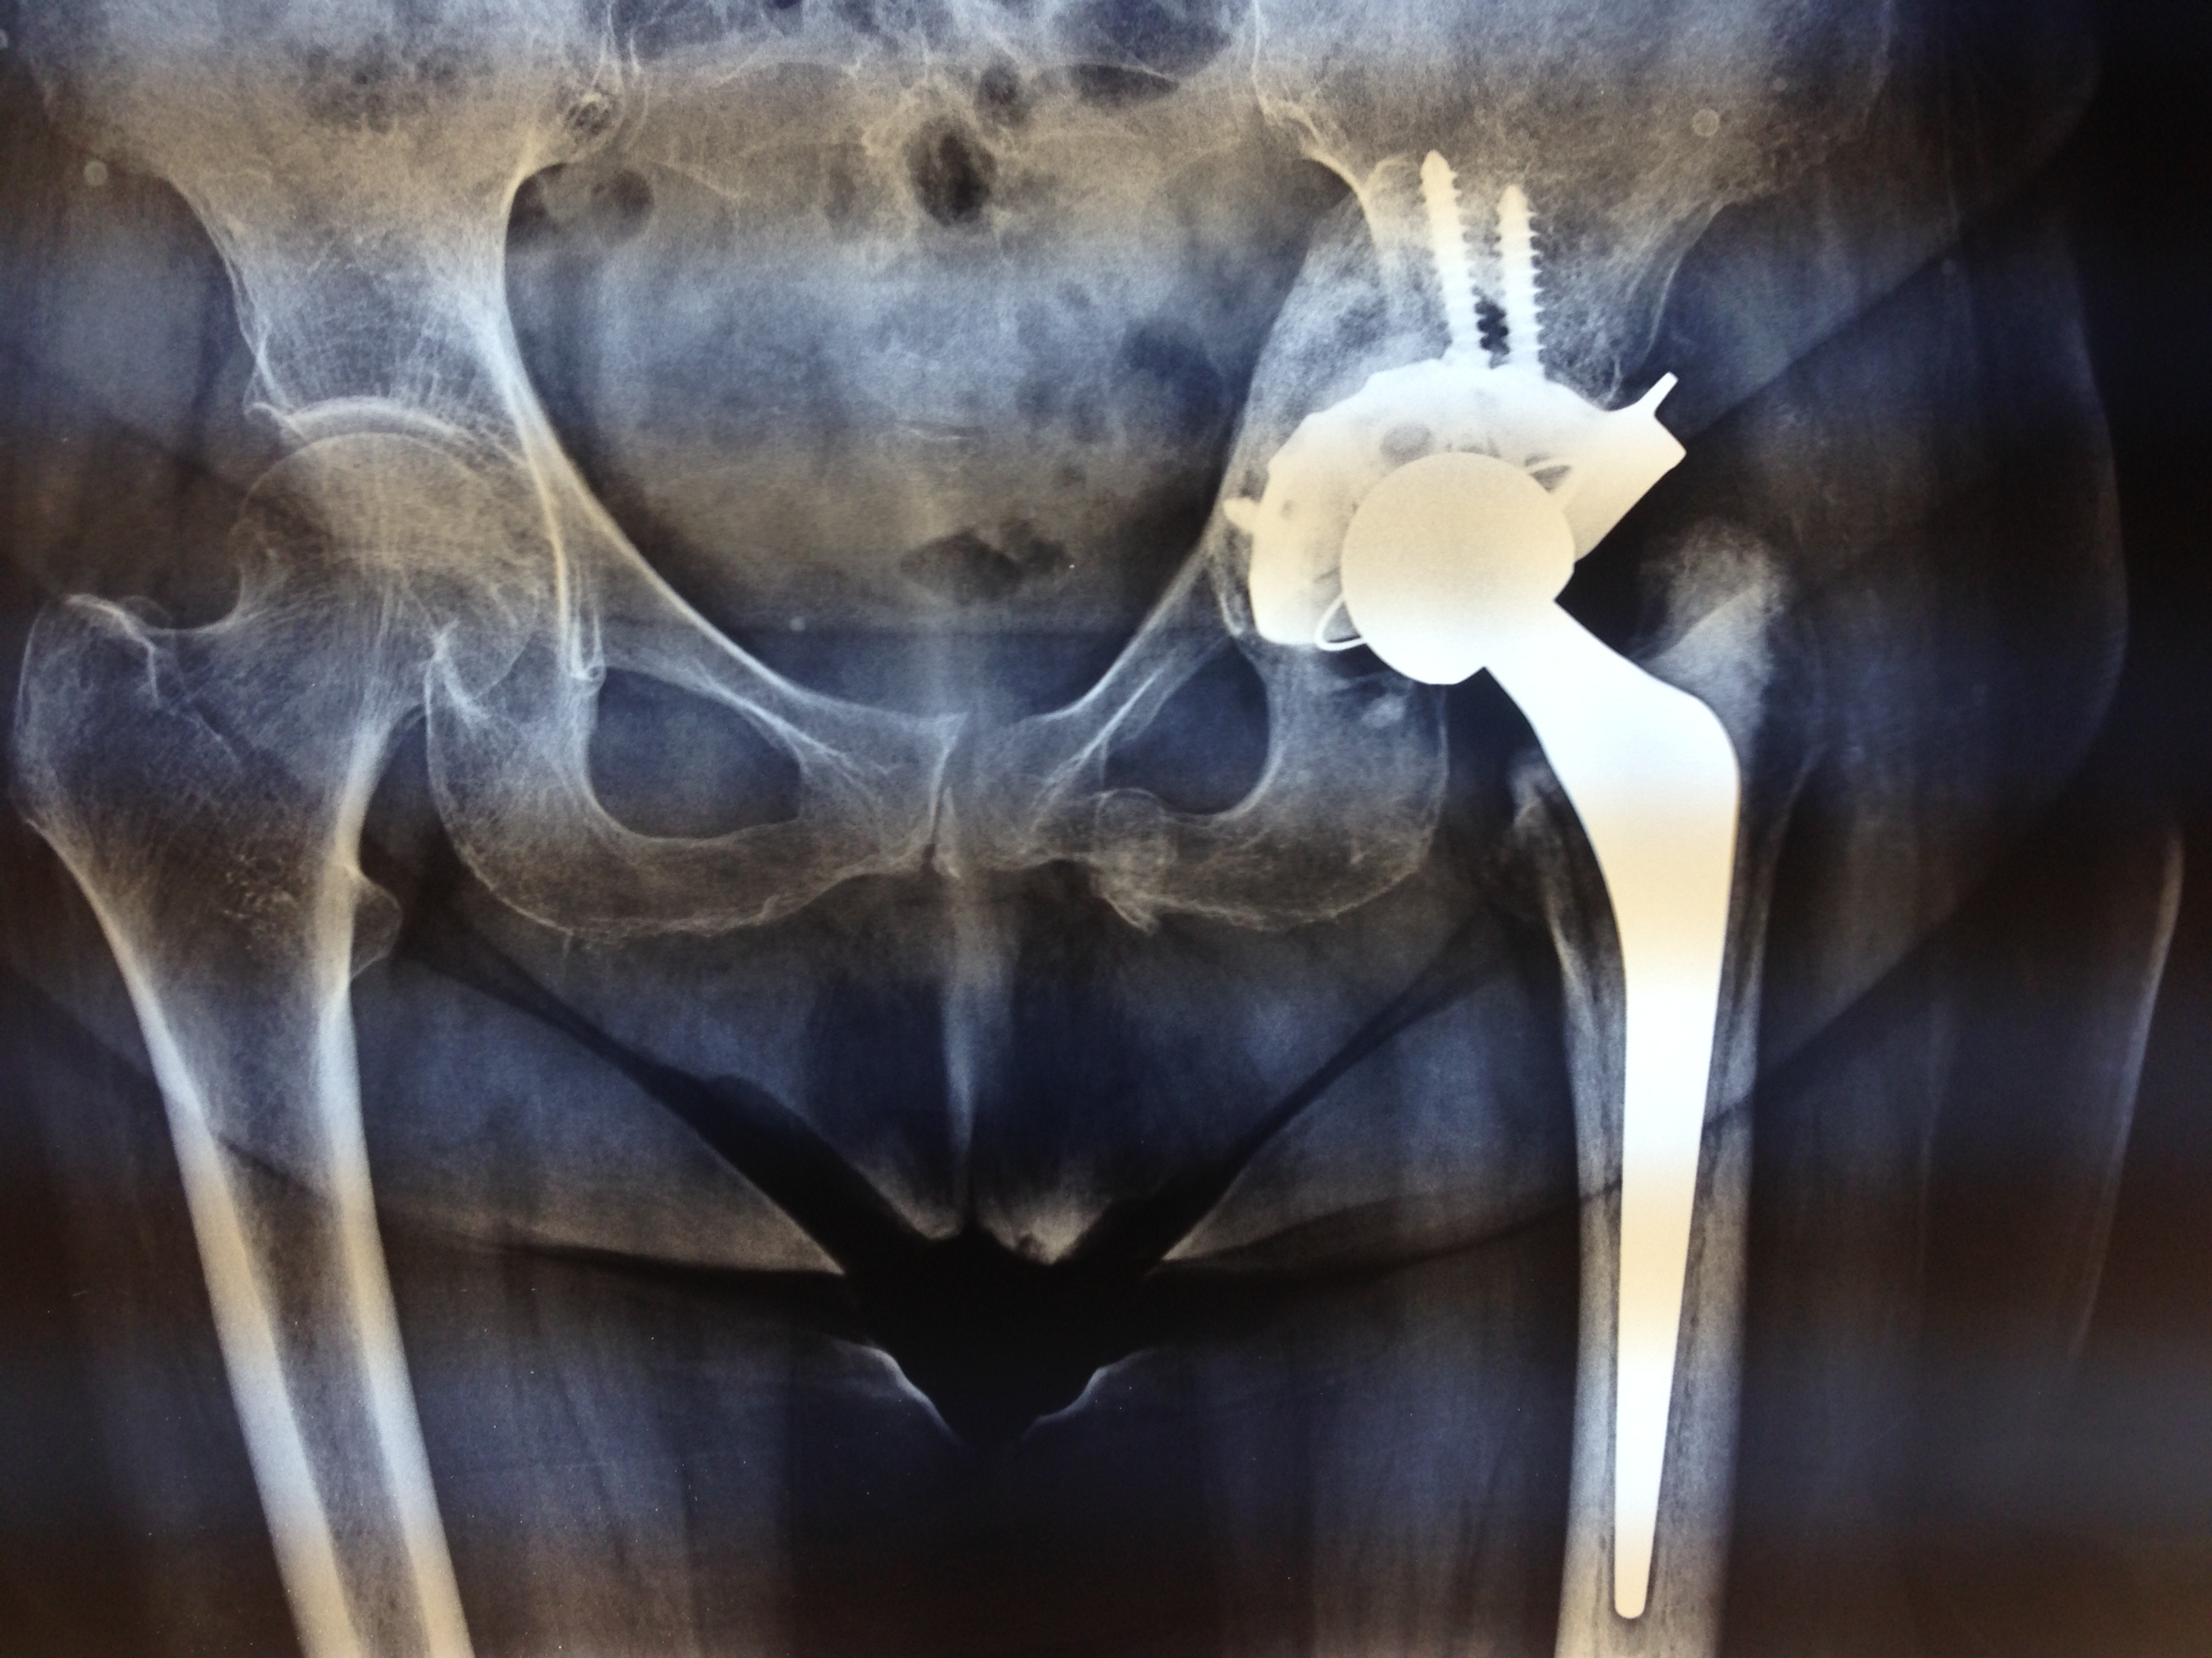

Slide 6
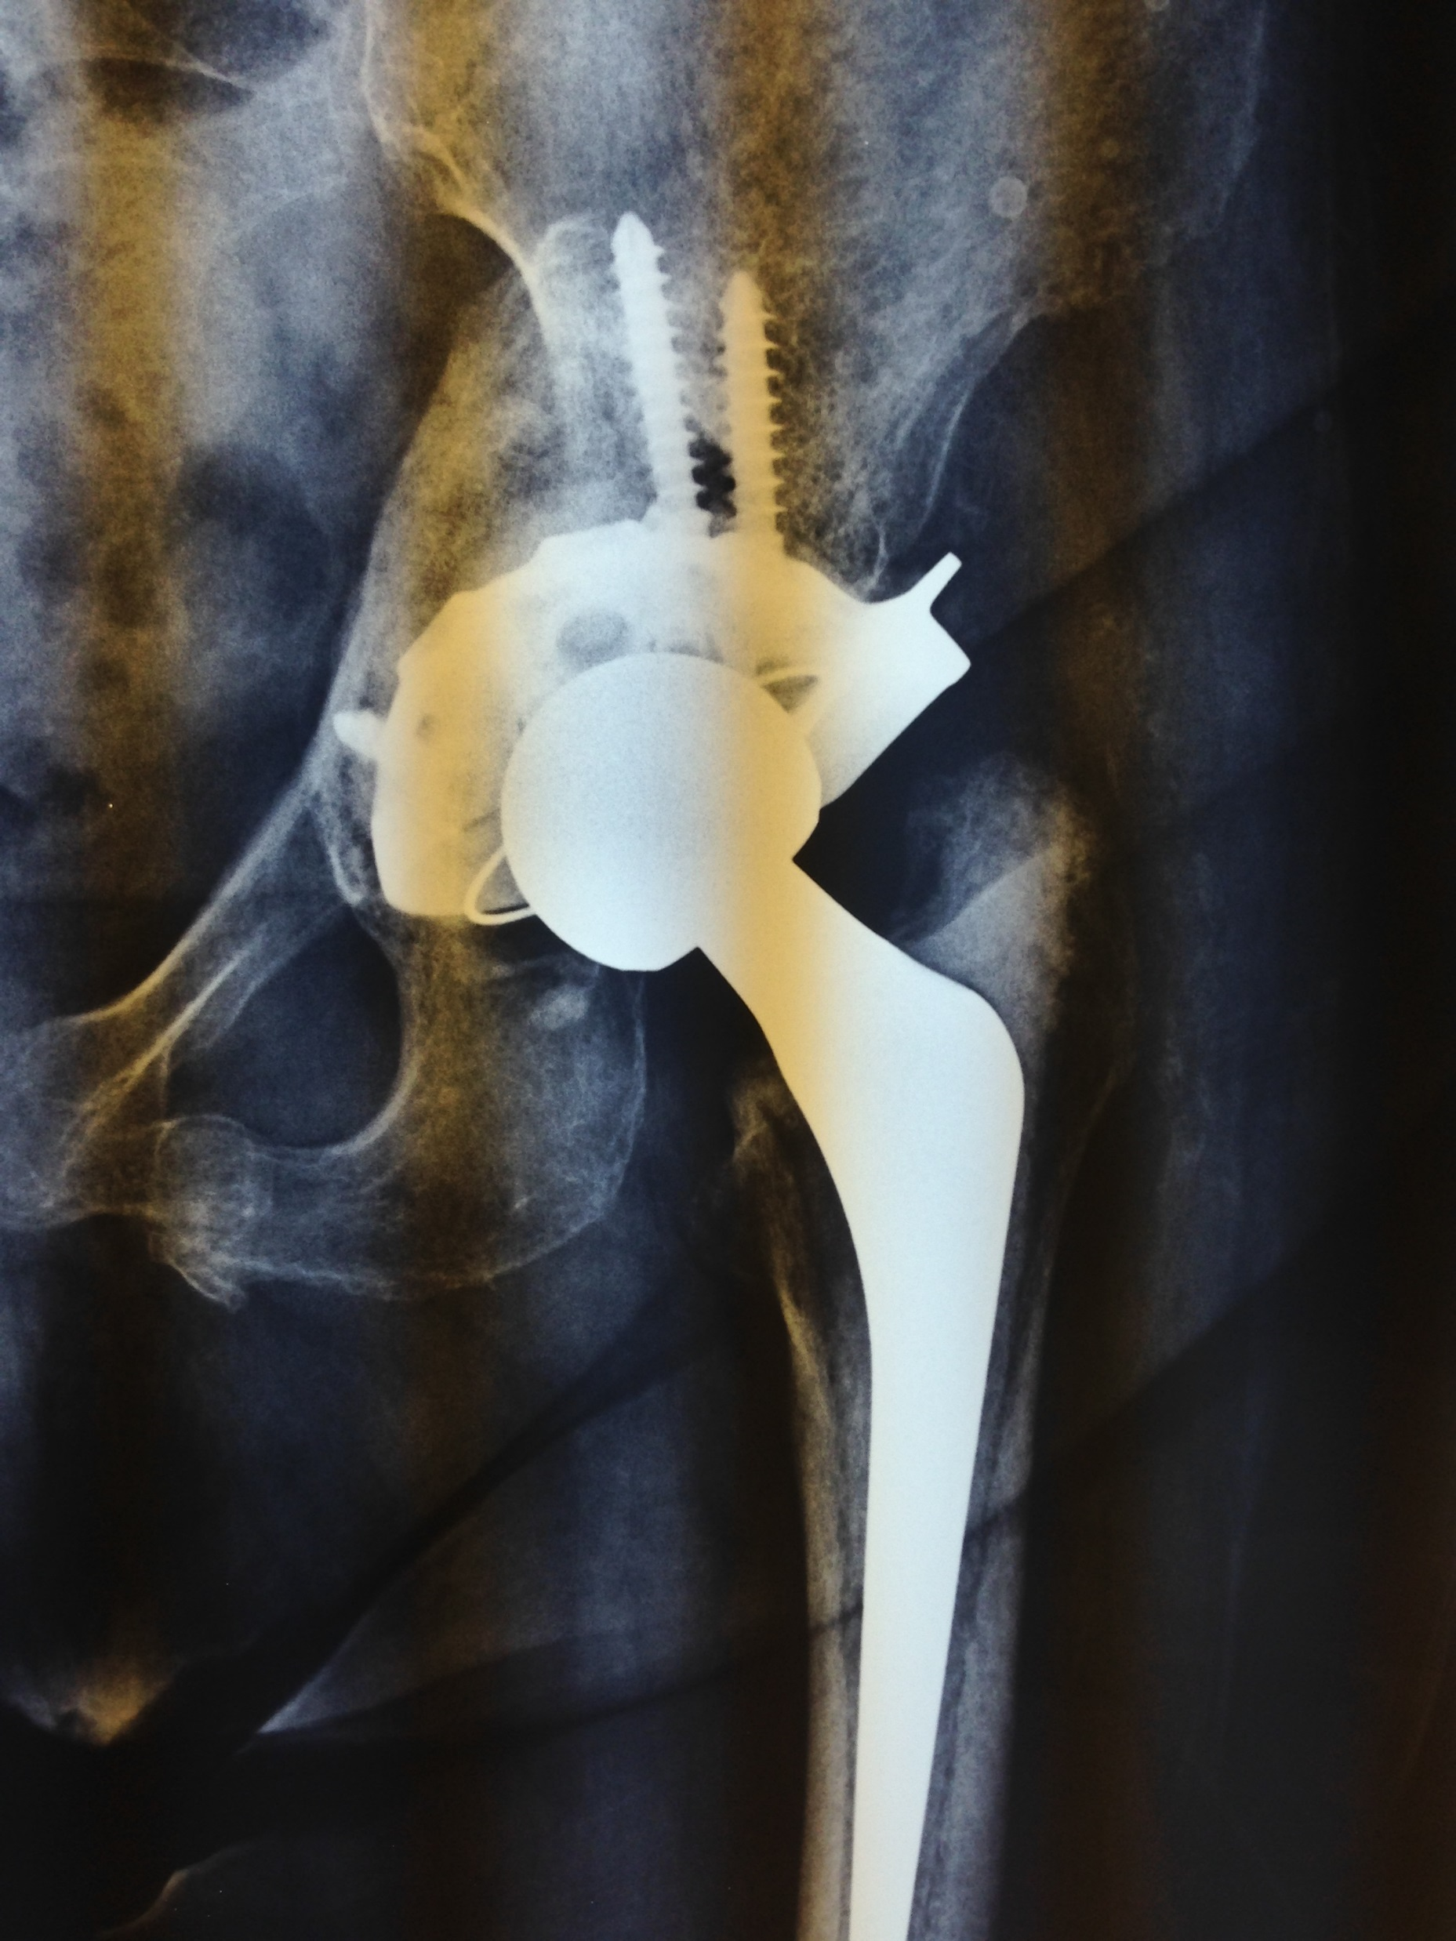

Slide 7
