Slide 1
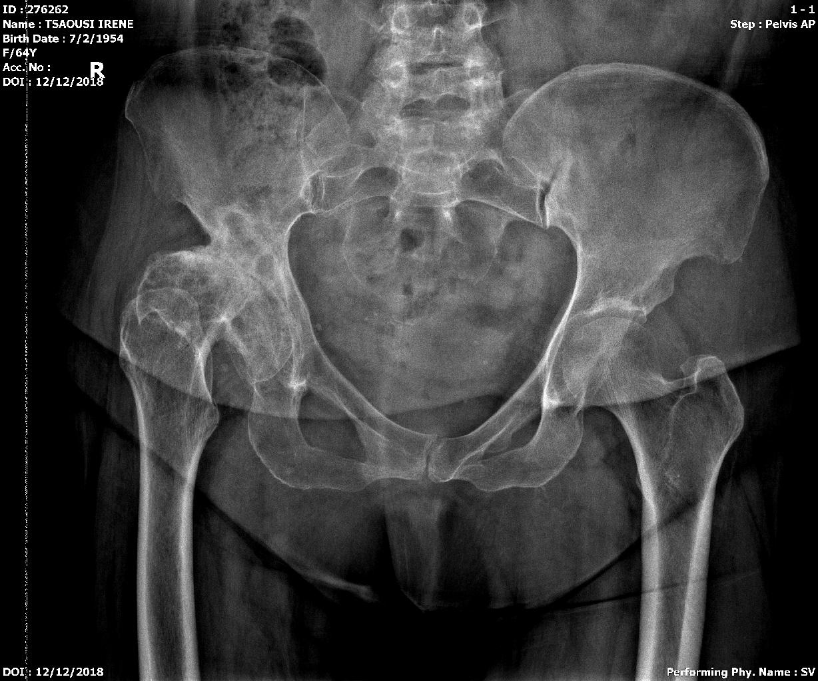
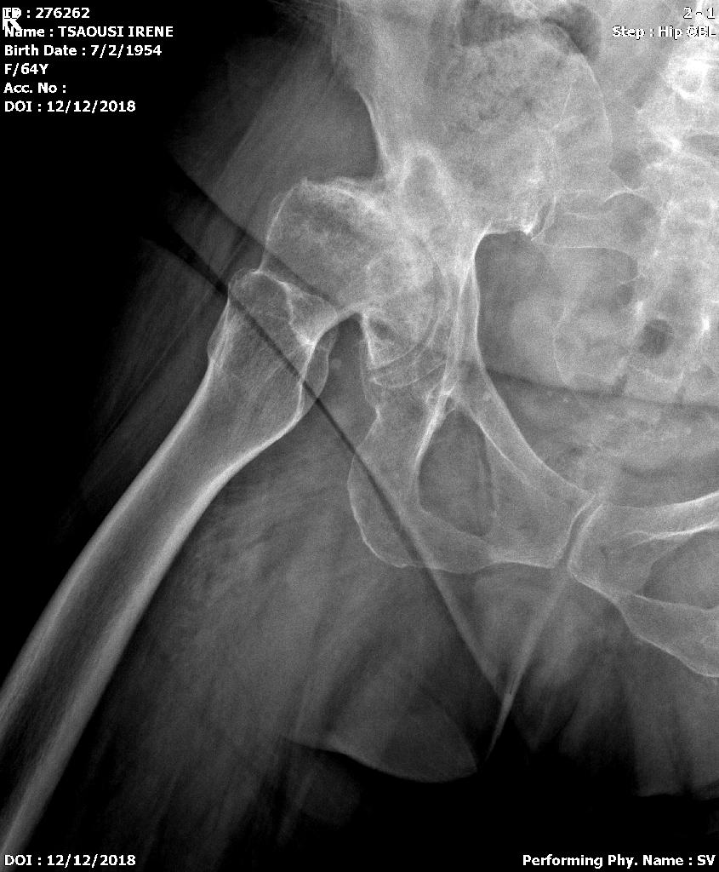
Severe deformity, dysplastic acetabulum from young age.
Shorter right leg by 3.5 cm.
Total Hip Replacement with reconstruction of the acetabulum.

Slide 2
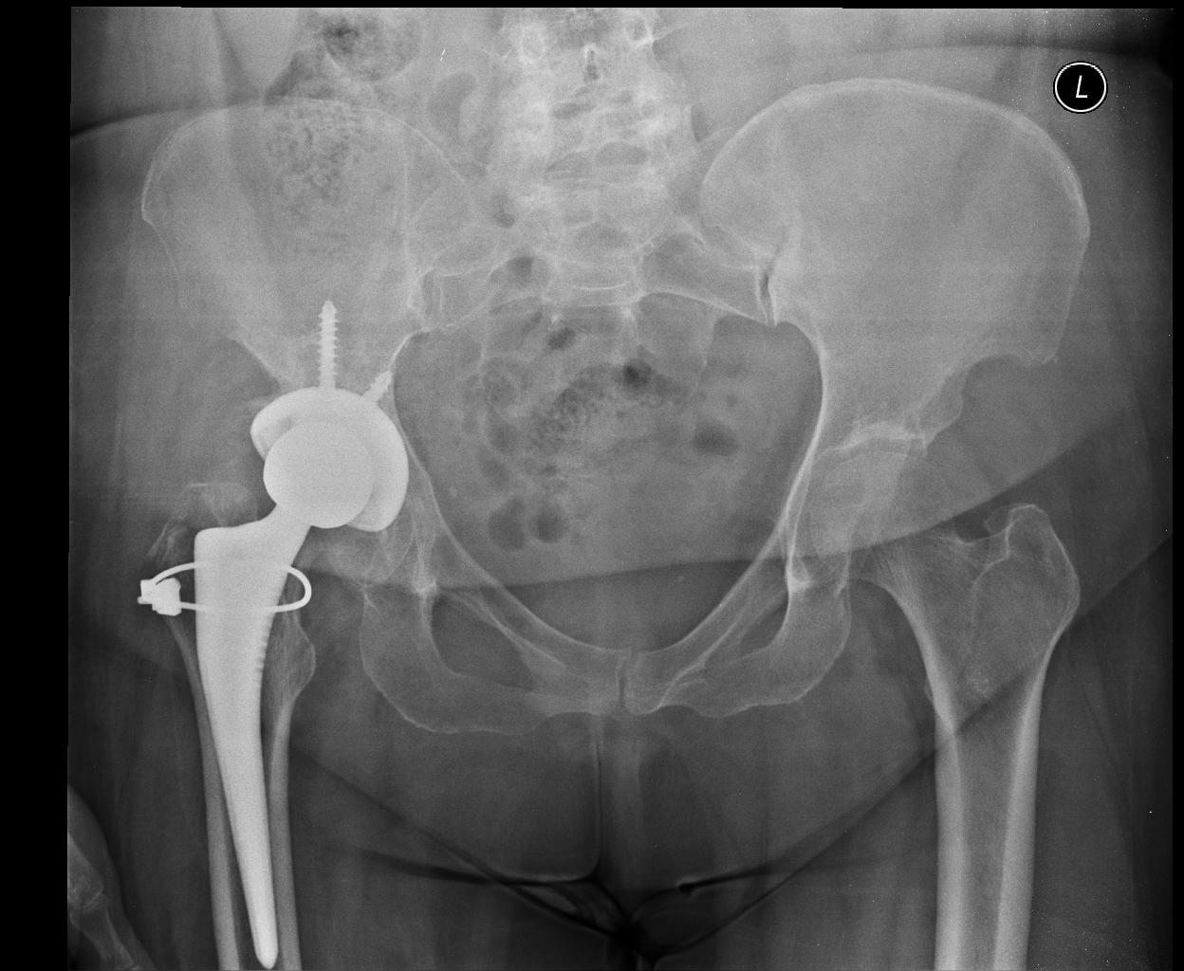
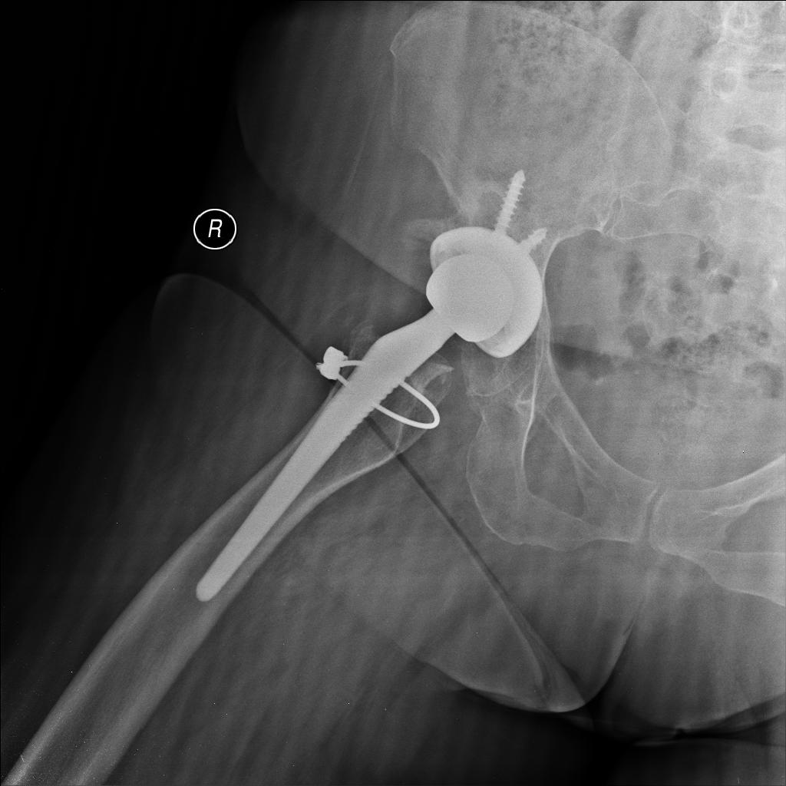
Post Operative X-rays for dysplastic acetabulum and false acetabulum

